Slide 1
Hungry Mile
MySQL
Title
Group 1
Reading Time: 60 mins
Credits: This presentation template was created by Slidesgo, including icons by Flaticon, and infographics & images by Freepik
[1] “Food Day Campaign” (https://slidesgo.com/theme/food-day-campaign#search-food&position-3&results-285 )
Notes:
36 simple slides *1 mins + 6 average slides * 3 mins + 12 title slides * 0.5 mins

Slide 2
ABOUT THE COMPANY
Simple
HUNGRY MILE
We are a small local online food ordering and food delivery platform working towards helping restaurants reduce food waste.
MISSION STATEMENT
We deliver your food and we go the extra mile for a better future
COMPANY SECTOR
Tech for Good
Reduce Carbon Emissions
Founded in 2019
100 employees
Gross revenue: $5.9M a year
Only serving the Bay Area
Avg. total orders in a day: 1200
Who we serve
Customers: 60k unique individuals
Current Partners: 500 partners
Fleet: 80 delivery partners^{[1]}
Company History
In 2019, we were a food delivery website for local businesses and have now transitioned to mobile app
In 2020, started working towards reducing food waste and have partnered with 200 of our businesses that includes restaurants, recycle centres, etc.
Product & Services
We currently have an established food ordering app where customers can order meals from their favorite restaurants.
We aim to reduce food wastage and partner with businesses to offer food or ingredients to be sold at discounted price.
^{[1]} Ratio for Customers to merchant partners : (118:1)
Ratio for Customers to orders per day: 50: 1
Avg of 2 deliveries in an hour per driver : 2(orders/hr)*8(hours)*80(drivers) = 1280 orders per day
[1] Curry, D. (2022)“Grubhub revenue and Usage report”, BusinessOfApps (https://www.businessofapps.com/data/grubhub-statistics/#:~:text=From%20a%20high%20of%2070,every%20year%20since%20going%20public.)

Slide 3
CURRENT SITUATION
Simple
Our company has been partnering with more restaurants every year increasing our revenue growth to 15% each year. With the pandemic situation, we have seen a surge in online ordering increasing our sales in the last month to $477,000.^{[1,2]}
Current Situation (2021-22) | Goal (2022 -23) | Notes
Our current conversion rate is 2.8% from Google and Facebook ads, with an increase of 3.7% from 2019. | The goal is to increase by 6% and reach our conversion rate to 2.968%^{[3]} | Marketing team currently only uses outsourced paid ads to target consumers who order food online. Marketing managers want to increase conversion rate by targeting more demographics such as age and geographical location, etc by analyzing internal customers’ data.
API latency time for the app is currently 3s and is leading to customer dissatisfaction | We need to improve the performance by 3 times reducing the response time to 1s^{[3]} | Currently, Excel offers a response time of 3s which creates a lag. MySQL will be solving this problem by optimizing the query and efficient MySQL server configuration.
Microsoft 365 currently costs the company $600/month | Move to MySQL by end of 2022. | For improved security and scalability we want to move to MySQL which would be an investment of $0 per year However, this would increase our ROI by 115%
Current revenue growth rate is 1.5% in 2021 | 5% increase in 2022 | HungryMile aims to increase the revenue by 3% for the next year.
[1] “1010data Market Insights Restaurant Delivery Report”, 1010data (2016) (https://info.1010data.com/rs/952-BWM-648/images/1010data_MarketInsightsReport_Disruptor_RestaurantDelivery_Q42016_16FEB17.pdf?aliId=10716783)
[2] Ang, C. (2022), “DoorDash is Dominating the U.S. Food Delivery Market”, Visual Capitalist (https://www.visualcapitalist.com/doordash-is-dominating-the-u-s-food-delivery-market/)
[3] Chaffey, D. (2022) “E-commerce conversion rates benchmarks 2022 – how do yours compare?” Smart Insights (https://www.smartinsights.com/ecommerce/ecommerce-analytics/ecommerce-conversion-rates/)
[4] “MySQL Performance Tuning and Optimization Tips” (2020), ( https://phoenixnap.com/kb/improve-mysql-performance-tuning-optimization)

Slide 4
PROBLEM STATEMENT
Average
At present the company is using Excel to store data due to which the company is suffering from the following challenges:
The live data are captured from our website and stored into a middleware, so our data administrator (DBA) manually transfers the data from the middleware into the excel files. When DBA finishes all the transfer job, we will remove the middleware and the data will be directly transferred from the website into MySQL server.
Scalability^{[1]}: HungryMile will soon reach 1 million order transactions and it will be difficult to maintain all order transactions in a single Excel file as Excel has a limitation of 1,048,576 rows. This may lead to errors in financial calculations.
App Performance^{[2]}: API latency time for the app is currently 3s. As per customer surveys, the app performance needs to be improved for better customer experience.
Data Accessibility: Spreadsheets require information to be loaded into the memory first unlike databases leading to slow access of large datasets^{[2]}.It can take minutes in SQL to do what it takes nearly an hour to do in Excel^{[4]}
Version Control: Employees have several copies of Excel and do not know which is the latest version which is making tracking changes difficult if several people are collaborating with Excel workbooks.^{[3]}
Security: Our Quarterly Sales data was recently leaked online even though it was password protected. After analysis it was found that hackers used tools on the Internet to unlock the protected Excel file without knowing the password.^{[3]}
Data integrity: Analytics team has raised an issue regarding limited validation for input in Excel. Current safeguards can be easily bypassed or ignored. As a result they have compromised and inaccurate data which is leading to incorrect predictions.^{[2]}
Redundancy: Since there is no Referential integrity it is difficult to ensure consistent and valid data within the database as data sets cannot be linked by the use of keys and relationships leading to duplication of source data.^{[3]}
Analysis: Excel is a flat file and doesn’t have any relationship with the data in other files which makes it difficult to
analyze data from different sources and generate insights.
[1] Excel for Microsoft 365 Excel (2021)”Excel specifications and limitations”(https://support.microsoft.com/en-us/office/excel-specifications-and-limits-1672b34d-7043-467e-8e27-269d656771c3)
[2] EarthSoft “Databases vs Spreadsheets”( https://earthsoft.com/2018/06/07/databases-versus-spreadsheets/)
[3] Cacace, M. (2014) “7 Reasons to Beware of Using Excel as a Database”, Bound States Software (https://boundstatesoftware.com/blog/7-reasons-to-beware-of-using-excel-as-a-database)
[4] Codeacademy (2018) “Excel to SQL”, (https://www.codecademy.com/resources/blog/excel-to-sql-why-switch/#:~:text=SQL%20is%20much%20faster%20than,functions%20you're%20probably%20using.)

Slide 5
Simple
OBJECTIVE
Technical
Easily^{[1]} extract data from the database to perform analytics and visualize it to generate useful insights.
By implementing new strategies revenues is expected to increase by 0.5%^{[2]}
Social
We proud ourselves in being a Tech for Good Business and we aim at reducing food wastage further by upgrading our social reach and expanding to new neighborhoods with the help of SQL database^{[3]}.
Improvement in the marketing strategy is expected to increase the revenue by 2.5%^{[4]}
Financial
Getting economic stability by attracting more investors resulting in increased profits.
To increase total revenue by 10% annually for the next 5 years
^{[1]} For more content on ‘Easily’, please refer to slide 14, bullet point 1.
^{[2]}User story 4
^{[3]}More information on slide 14
^{[4]} User story 6

Slide 6
Simple
MySQL OVERVIEW
SQL stands for Structured Query Language and MySQL Server provides a robust Relational Database Management System. MySQL is free and open-source software and also available under a variety of proprietary licenses. It was owned and sponsored by the Swedish company MySQL AB (later was acquired by Oracle Corporation.) ^{[1]} It focuses on speed and reliability. ^{[2]} MySQL has been updated frequently for the existing and new features and improvements on security and is supported by a group of community developers when troubleshooting is needed. ^{[3]}
Key Features
Uses tables as key components
Use of Secure Socket Layer SSL to ensure data integrity ^{[4]}
Low memory leakage problem
Can run on cloud platforms ^{[5]}
Server optimization ^{[5]}
Allows transactions to be rolled back, commit, and crash recovery ^{[4]}
Support Services
MySQL Training: Provides different training programs for personnel who interact with the Database on the daily
MySQL Certification: Provides Developers and DBAs with credentials
MySQL Consulting: Oracle offers a full range of consulting services
MySQL Support: Oracle offers MySQL Technical Support
[1] “MySQL”, Wikipedia (https://en.wikipedia.org/wiki/MySQL)
[2] Wolfe, M. (2021) “MySQL vs PostgreSQL Comparing the Relational Database Management System to the Object-Relational Database Management System” (https://towardsdatascience.com/mysql-vs-postgresql-3d48891452a)
[3] Phaujdar, A. (2021)“PostgreSQL vs MySQL: 8 Critical Difference”(https://hevodata.com/learn/postgresql-vs-mysql/)
[4] “Architecture of MySQL” (2021) GeeksforGeeks (https://www.geeksforgeeks.org/architecture-of-mysql/
[5] Smallcombe, M. (2020) “PostgreSQL vs MySQL: The Critical Differences” (https://www.integrate.io/blog/postgresql-vs-mysql-which-one-is-better-for-your-use-case/)

Slide 7
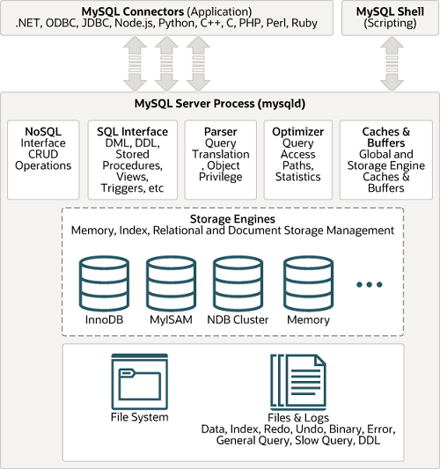
Average
OSS PRINCIPLES & ARCHITECTURE
Upstream C, C++ | Downstream Drupal, Joomla, phpBB, and WordPress ^{[1]}
Sponsors NuSphere, Intel, Stork Design Studio, Compaq, SWSoft | Distributors Community of Open Source Developers
End User Facebook, Adobe, Google, Uber ^{[2]} | Maintainers Community of Open Source Developers
Competitors Microsoft Access, PostgreSQL, Amazon RDS ^{[3]} | Contributors Steve Harvey, Google Inc., David Hughes
^{[4]}
MySQL Architecture has
three main layers
Client ^{[5]}
1. Connection Handling
2. Authentication
3. Security
Server ^{[5]}
1. Thread handling
2. Parser
3. Optimizer
4. Query cache
5. Buffer and cache
6. Table metadata cache
7. Key cache
Storage Layer ^{[5]}
1. InnoDB
2. MYiSAM
3. NDB
[1] “MySQL”, Wikipedia (https://en.wikipedia.org/wiki/MySQL)
[2] Kili, A. (2020) “What is MySQL? How Does MySQL Work?” Tecmint. (https://www.tecmint.com/what-is-mysql-how-does-mysql-work/)
[3] “Top 10 MySQL Alternatives & Competitors” G2 (https://www.g2.com/products/mysql/competitors/alternatives)
[4] “16.11 Overview of MySQL Storage Engine Architecture” MySQL (https://dev.mysql.com/doc/refman/8.0/en/pluggable-storage-overview.html)
[5] “Architecture of MySQL”, (2021). GeeksforGeeks ( https://www.geeksforgeeks.org/architecture-of-mysql/)

Slide 8
COMPETITOR ANALYSIS
MARKET SHARE
15.34%^{[4]}
MySQL
MySQL is used by 33,295^{[4]} companies in the industry.
11.15%^{[4]}
Microsoft Access
Microsoft Access is used by 24,179^{[4]} companies in the industry.
8.21%^{[4]}
PostgreSQL
PostgreSQL is used by 17,808^{[4]} companies in the industry.
Simple
 | PostgreSQL | MySQL
 | Open source database (Both supports network fault tolerance)
Development | Project ^{[2]} | Product ^{[2]}
Architecture | Object-Relational DBMS ^{[1]} | Relational-DBMS ^{[1]} (community-driven)
Platform | Mac, Windows, and Linux ^{[3]}
Licensing | MIT-style license ^{[2]} | GNU General Public License ^{[2]}
Implementation programming languages | C ^{[2]} | C/C++ ^{[2]}
Cloud version | No ^{[3]} | Yes ^{[3]}
Programming Languages it supports | C/C++, Java, Perl, Net, R, Python, JavaScript, etc. ^{[3]} | C/C++, Erlang, Perl, PHP, GO, Java, R, Delphi, Node.js Lisp ^{[3]}
GUI tool | PgAdmin ^{[2]} | MySQL Workbench ^{[2]}
Storage engine | Single ^{[2]} | Multiple ^{[2]}
Performance | For high volume of both reads and writes ^{[1]} | For high volume of reads ^{[1]}
[1] Chen, B. (2021). “PostgreSQL vs. MySQL: What You Need to Know” Fivetran (https://www.fivetran.com/blog/postgresql-vs-mysql)
[2] “PostgreSQL vs. MySQL” PostgreSQL Tutorial. (https://www.postgresqltutorial.com/postgresql-tutorial/postgresql-vs-mysql/)
[3] Peterson, R. (2022). “13 BEST Free Database Software (SQL Databases List) in 2022”. Guru99. (https://www.guru99.com/free-database-software.html)
[4] “MySQL Market Share and Competitor Report: Compare to MySQL, Microsoft SQL Server, Microsoft Access”, Datanyze (https://www.datanyze.com/market-share/databases--272/mysql-market-share)

Slide 9

MYSQL Edition Selection
SWOT ANALYSIS
MySQL Community
Edition
MySQL Enterprise Edition
Our Choice
Simple
Strengths
Reduced Total Cost of Ownership^{[3]}
Comprehensive Transactional Support^{[3]}
Data Security and Scalability^{[4]}
Weaknesses
Paid databases have better developing and debugging tools
May underperform when it^{[2]} comes to heavy loads or complex queries.^{[5]}
Free to use
Multiple storage engines offered
Allows the user to access and modify the source code^{[8]}
24 x 7 Support from Oracle
Annual Subscription: from $2000.00 to $5000.00
Opportunities
Address a growing market size
Handle a growing customer base efficiently and with improved data security
Improved database accessibility
Threats
Susceptible to data corruption^{[6]}
It is easy to be imitated^{[7]} and threat of substitute products^{[1]}
MySQL Community Edition
[1] “Mysql Open Source Database In Harvard Case Study Solution & Online Case Analysis”, CaseRighted ( https://caserighted.com/mysql-open-source-database-in/)
[2] “MySQL Advantages And Disadvantages” W3schools. (https://www.w3schools.blog/mysql-advantages-disadvantages )
[3] “Top Reasons to Use MySQL), DatabaseQuest, Inc. (http://www.databasequest.com/index.php/product-service/mysql-dbquest)
[4] Branson, T. (2016) “8 Major Advantages of Using MySQL” Datamation. (https://www.datamation.com/storage/8-major-advantages-of-using-mysql/ )
[5] Sagar, B. (2022) “PostgreSQL vs MySQL: Everything You Need to Know in 2022” (https://hackr.io/blog/postgresql-vs-mysql)
[6] Drake, M. (2019) “How To Fix Corrupted Tables in MySQL” ( https://www.digitalocean.com/community/tutorials/how-to-fix-corrupted-tables-in-mysql)
[7] Ghosh, S. (2011) “MySQL Case Study” (https://www.slideshare.net/sharathghosh/mysql-case-study)
[8] “How to choose between MySQL Community Edition Vs Enterprise Edition”, Optimizdba (https://optimizdba.com/mysql-database-community-vs-mysql-enterprise/)
[9] “ MySQL Products”, MySQL (https://www.mysql.com/products/)

Slide 10

Features of MySQL
Community Edition
Title
Pluggable storage engine architecture^{[1]} (InnoDB, NDB, MyISAM) ^{[1]}
Stored procedures, triggers, views ^{[1]}
MySQL Replication & Group replication ^{[1]}
Improves developer productivity; enforce complex business rules; ensure sensitive information is not compromised^{[1]}
Improves application performance and scalability ^{[1]}
InnoDB Cluster ^{[1]}
Performance and information schema ^{[1]}
Brings high availability solution for MySQL ^{[1]}
Provides easy access to metadata^{[1]}
[1] “MySQL Community Edition”, MySQL (https://www.mysql.com/products/community/)

Slide 11
Title
REASONS FOR CHOOSING MySQL
 | Easier to manage large databases: Large datasets slow down the computer when accessed through Excel while MySQL makes managing large datasets easier and does not slow down the system.^{[1]}
 | Relational databases: Excel is a flat file database while MySQL is a relational database which makes accessing data/tables easier.
 | Scalability: Using Excel increases the server response time and creates issues with scalability while MySQL will help overcome scalability issues.^{[2]}
 | Data Security: MySQL provides end-to-end data security and is compliant with the major privacy regulations and data protection laws.^{[2][3]}
 | Improved Page Load Time: Page Load Time and Page Response Time is an important aspect of customer experience and with a growing database, Excel would slow down the response time while MySQL provides improved application performance.^{[2]}
 | Backup and Recovery: MySQL offers various methods for creating backups.^{[4]}
[1] Hershy, A. (2019), “Excel v/s MySQL: A Conceptual Comparison”, Towards Data Science (https://towardsdatascience.com/excel-vs-sql-a-conceptual-comparison-dcfbee640c83)
[2] “Custella Boosts its SaaS Application”, MySQL (https://www.mysql.com/why-mysql/case-studies/custella-saas-migrating-to-mysql-database-service.html)
[3] “Chapter 6 Security”, MySQL (https://dev.mysql.com/doc/refman/8.0/en/security.html)
[4] “Chapter 7 Backup and Recovery”, MySQL (https://dev.mysql.com/doc/refman/8.0/en/backup-and-recovery.html)

Slide 12
OSS SUMMARY
Title
MySQL is available under the GPL license and supported by a huge and active community of open source developers. ^{[1]}
Having end users like Facebook and Google are a testament to MySQL’s robust security and scalability features.
With a growing customer base, the need to move from flat files in Excel to a Relational Database such as MySQL was becoming a necessity for Hungry Mile in order to analyze important business insights.
Accessing large datasets via Excel slows down the local computer and pulling data becomes time consuming and memory intensive. Moving to MySQL will make handling large volumes of data easier.
The Total Cost of Ownership is reduced with MySQL’s database server and architecture that uses low-cost commodity hardware. ^{[2]}
[1] “MySQL”, Wikipedia (https://en.wikipedia.org/wiki/MySQL)
[2] “Top Reasons to Use MySQL), DatabaseQuest, Inc. (http://www.databasequest.com/index.php/product-service/mysql-dbquest)

Slide 13
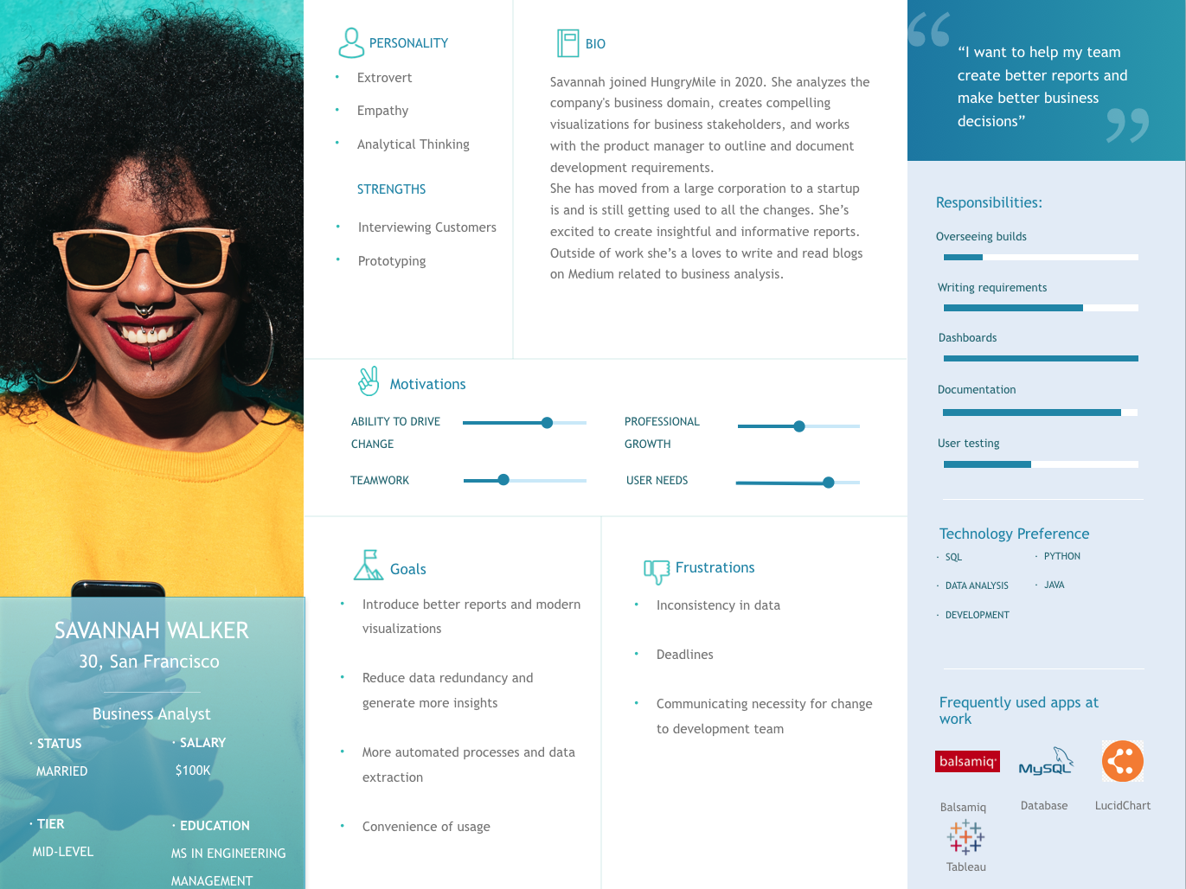
PERSONA 1
Title
[1]
[2]
[3]
[4]
[1] “30 must-see user persona templates” Justinmind.
(https://www.justinmind.com/blog/user-persona-templates/)
[2] “Balsamiq brand Assets”, (https://balsamiq.com/company/brandassets/)
[3] “MySQL logo transparent PNG” (https://www.subpng.com/png-1h7rzt/)
[4] “Lucid PNG images” (https://www.pngwing.com/en/search?q=lucidchart)
[5] “Tableau Logo”, (2022) (https://logos-world.net/tableau-logo/)
[5]

Slide 14
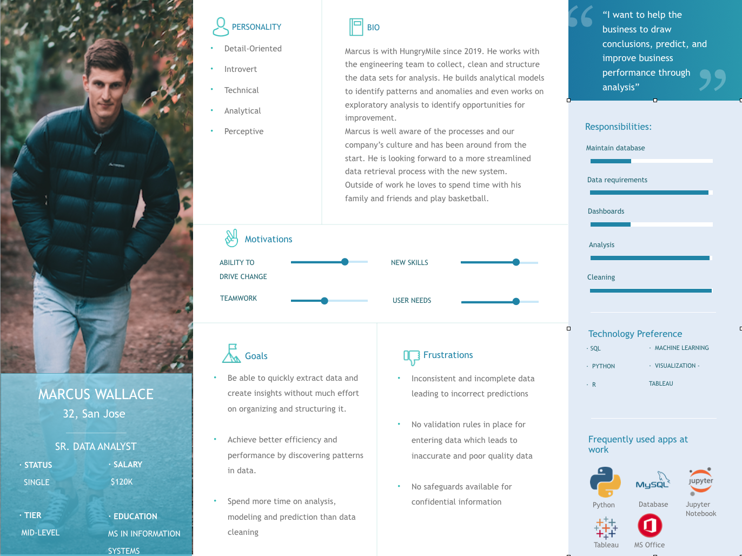
PERSONA 2
Title
[1]
[2]
[3]
[4]
[1] “30 must-see user persona templates” Justinmind. (https://www.justinmind.com/blog/user-persona-templates/)
[2] Wallis M.,”Unsplash.com” (2018) (https://unsplash.com/photos/UAMoXApIOsI)
[3] “MySQL logo transparent PNG” (https://www.subpng.com/png-1h7rzt/)
[4] Wikimedia.org, “File:Jupyter logo.svg” (https://commons.wikimedia.org/wiki/File:Jupyter_logo.svg)
[5] “Tableau Logo”, (2022) (https://logos-world.net/tableau-logo/)
[6] Pipalva, A. “Circle Microsoft office icon” (https://www.iconfinder.com/icons/3069728/circle_microsoft_microsoft_office_office_round_icon_icon)
[5]
[6]

Slide 15
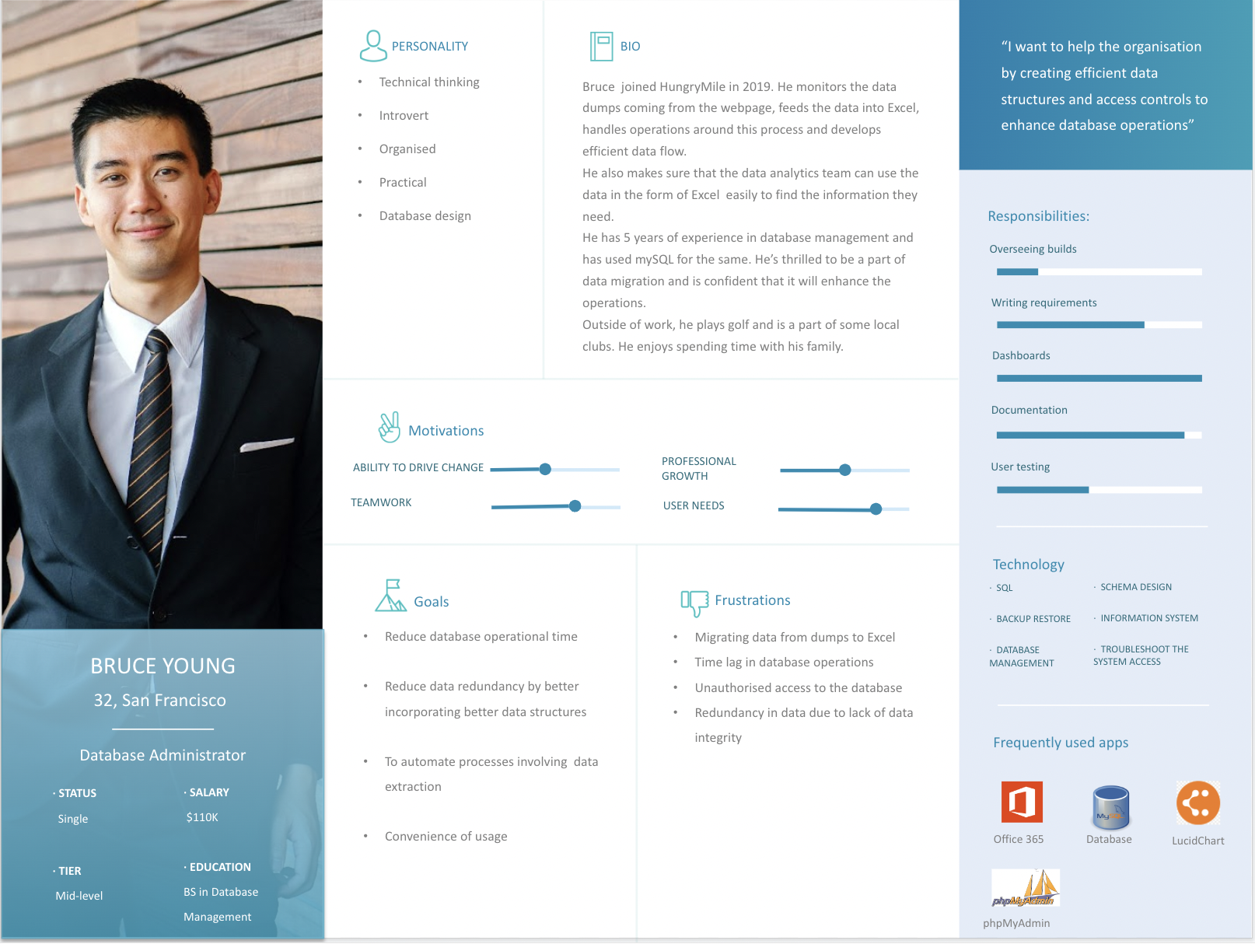
PERSONA 3
Title
[2]
[1]
[4]
[3]
[5]
[1] “30 must-see user persona templates” Justinmind. (https://www.justinmind.com/blog/user-persona-templates/)
[2] mentatdgt. “Man Wearing Black Suit Jacket and Pants · Free Stock Photo”(https://www.pexels.com/photo/man-wearing-black-suit-jacket-and-pants-937481/ )
[3] “Database icon” (https://logodix.com/database )
[4] Pipalva, A. “Circle Microsoft office icon” (https://www.iconfinder.com/icons/3069728/circle_microsoft_microsoft_office_office_round_icon_icon)
[5]“Lucid PNG images” (https://www.pngwing.com/en/search?q=lucidchart)
[6] “phpMyAdmin icon” (https://www.freeiconspng.com/images/phpmyadmin-icon)
[6]

Slide 16
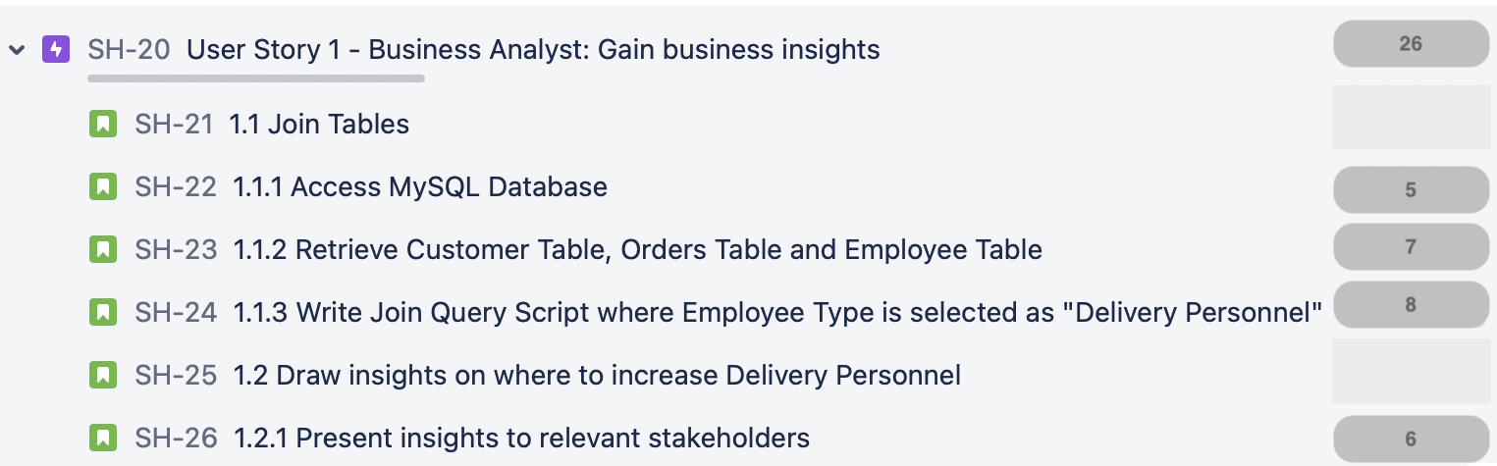
Simple
User Story 1
Epic: Storing and Retrieving Data
Functional Requirements
Run query by joining multiple tables (more than 2) to gain business insights.
Easy and quick retrieval of the Customer table, Orders table and Employee table.
User Story
As Savannah Walker(Business Analyst), I want to use the relational database to join multiple tables such as writing a join query to join the Customer table, Orders table and the Employee table(type of Employee: Delivery Personnel) so that I can to get insights to understand in which areas to increase number of Delivery Personnel which in turn will increase customer satisfaction scores as deliveries will be faster.
Acceptance Criteria
Database should contain the Customer, Orders and Employees tables.
Data for the past month should be available.
When the query is run, it should display the results or errors in the query, if any.
Ensure that customer satisfaction of customers in these areas is above 7 on a scale of 10.

Slide 17
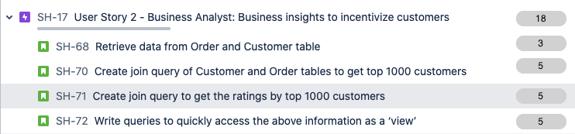
Simple
User Story 2
Epic: Storing and Retrieving Large Datasets
Functional Requirements
Retrieval of our 60k Customer dataset and Order dataset including information about customer address, contact information and order history to generate more customer and order insights, and ensure an automated process for easy data extraction.
User Story
As Savannah Walker (Business Analyst), I want to analyse Customer and Order datasets using SQL techniques like joins and procedures so that we can improve customer loyalty by providing returning customers with coupons and incentivize them for choosing our services.
Acceptance Criteria
There must exists SQL based views for top 1000 customers (VIP) by number of orders placed by them in the previous month.
Orders which are cancelled should not be a part of the top 1000 customer dataset.
The view must include the Customer’s Email address, Contact Information and Location.
SQL Procedure to find out 15 zip codes which have the lowest number of orders placed.
SQL Script calculating the average of the top 1000 customer’s rating in the past month.

Slide 18
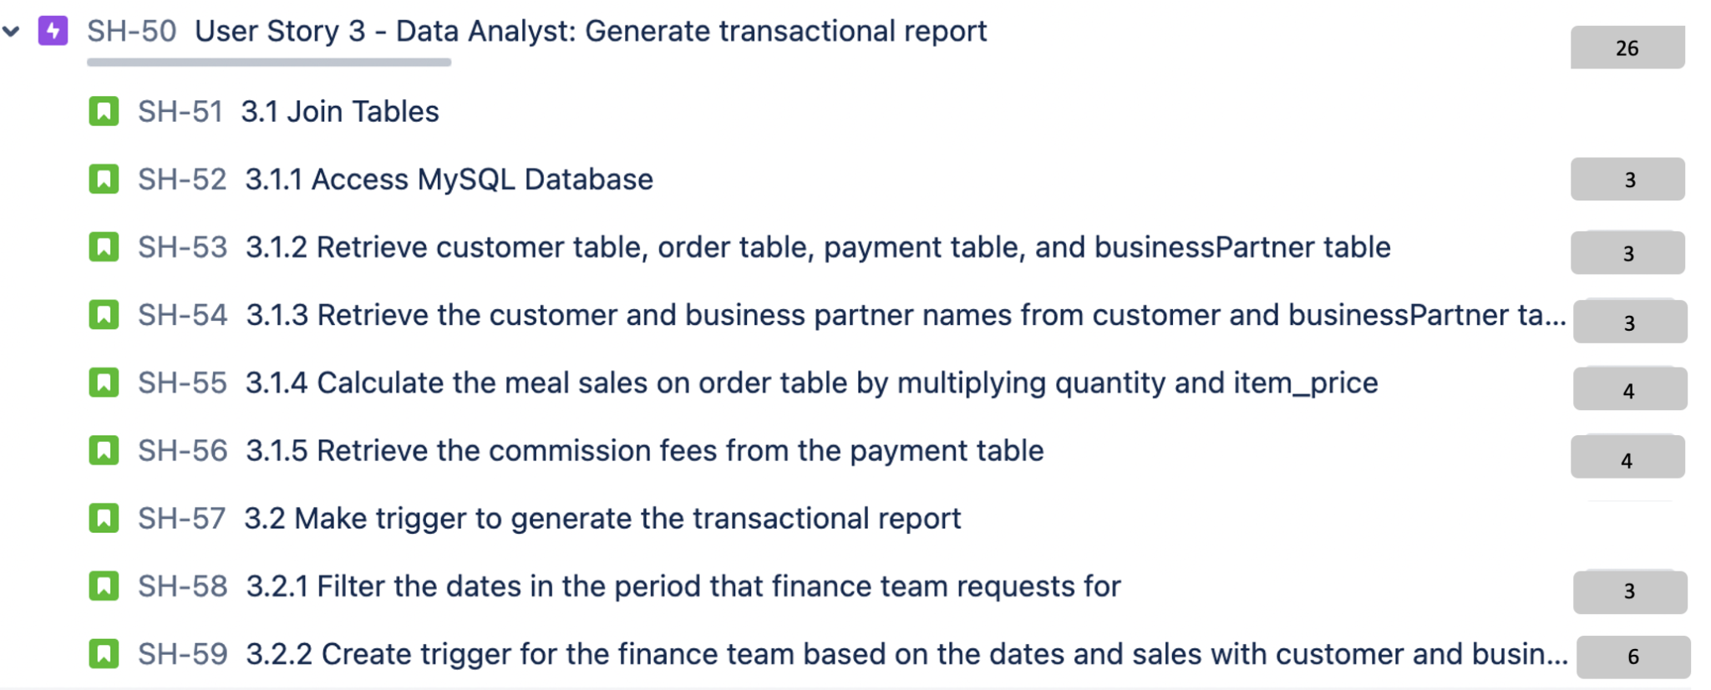
Simple
User Story 3
Epic: Storing and Retrieving Large Datasets
Functional Requirements
Retrieval of the transactional datasets (customer names from the customer table and business partner names from the businessPartner table, and customer and business partner payment record from the order and payment table).
User Story
As Marcus Wallace (Sr. Data Analyst), I want to be able to extract data joining the customer table, payment table, order table and businessPartner table and use trigger to automatically generating the transactional report for the finance team so that the finance team can prepare financial report on revenue part for tax return purpose or for doing the sales analysis to see how the company is performing in terms of sales perspective.
Acceptance Criteria
The transactional report must have the sales data including meals fee and shop/restaurants commission fee.
The report must display sales data based on the time frame (can be quarterly, monthly, yearly) requested by the finance team.
The report should include dates, and customer and business partner names without null values.
The report should have amount great/less than 0.

Slide 19
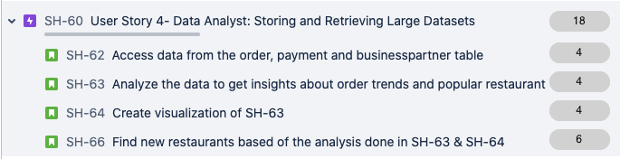
Simple
User Story 4
Epic: Storing and Retrieving Large Datasets
Functional Requirements
Retrieval of huge amount of order data
User Story
As Marcus Wallace (Sr. Data Analyst), I want to be able to retrieve large amount of order data from ‘order’ table, ‘payment’ table and ‘businessPartner’ table so that we can see customer’s order trend and accordingly provide analysis to rank the popular restaurants. We can then decide if our company needs to explore more potential similar alternatives to satisfy customers’ need. By adding new restaurants we expect our business to grow, resulting in an increase in revenue by 0.5%*.
Acceptance Criteria
The row of the dataset must be able to exceed 10 million rows because Excel’s current limitation is 1048576 rows.
The order must contain the shop or restaurant name, cuisine/category of food, restaurants’ location/distance, business hours, item price.
The order must have the sales from largest to smallest amount and be filtered by cuisine and location.
Notes:
*using the new insights which have been provided with this data analysis, we plan to add at least 3 new restaurants(0.5% of total restaurant partners) which satisfy the popular order trend. This will roughly translate into revenue increase by 0.5%.

Slide 20
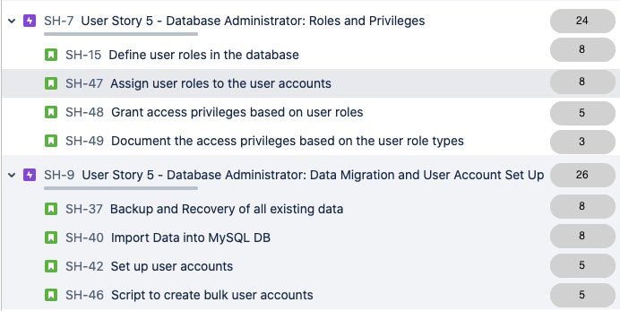
Simple
User Story 5
Epic: Security Improvements
Functional Requirements
Restrict access to privileged information by setting access permissions to view, edit and modify data.
User Story
As Bruce Young (Database Administrator), I want to utilize the security features in MySQL to set up user groups and assign privileges based on their roles restricting access of objects such as tables, columns, indexes, views, and stored routines within the database so that, I can manage data confidentiality, integrity, and availability to User groups allowing them access to perform actions that are permitted to them.
Acceptance Criteria
Employees with low level authorization(read-only) must not be able to perform UPDATE, DELETE queries.
Incorrect password must prevent access to the database.
Connection to the database must be end to end encrypted.
DBA must be able to create roles and GRANT privileges to them
DBA must be able to REVOKE
access for objects in the database

Slide 21
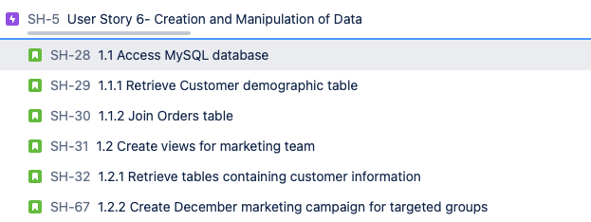
Simple
User Story 6
Epic: Creation and Manipulation of Data
Functional Requirements
Allow retrieval of data from multiple sources in order to create Views for Marketing team that has no authorization to UPDATE or DELETE queries and have limited knowledge on SQL.
User Story
As Bruce Young (Database Administrator), I want to create ‘Views’ For the Marketing team so that, they can analyze our 60k customer demographics including age, gender and geographical location and target the customer groups for their Dec marketing campaign, helping to increase the revenue by 2.5% due to improvement in marketing strategy.
Acceptance Criteria
The data of customer demographics should not include null values.
The dataset should include Names, addresses, gender, age and location of the customers; it should also have the Transaction history from last quarter to calculate the total order cost for a cohort in a location.
View should have sorted information on total spent from largest to smallest grouped by location and age.
18
3
3
3
3
3
3

Slide 22
PRODUCT ROADMAP
Simple
May 2022
June 2022
Jul 2022
Aug 2022
Sep 2022
Oct 2022
Nov 2022
Milestones
Release 1
Release 2
Goals/
Themes
DBA can Grant or Revoke access privileges for confidential information
BA can identify areas to increase delivery personnels
Queries and procedures for BA to identify and incentivize returning customers
DA can retrieve restaurant data to analyze customer order trend
DA can generate transactional report for finance team to analyze sales data
DBA can create SQL Views for marketing team to identify target customers
Change Management
Training in MySQL for and feedback analysis
Training in MySQL for and feedback analysis
Business Objective
Reduce risk of data breach
Improve app rating by 2 points
Customer 6 month retention rate improved by 15%
Identify restaurant partners increasing in business growth by 0.5%
Reduce expense and effort by ~$10,000 for data analyst on reporting
Increase revenue growth by 2.5% by improved marketing strategy
DBA: Database Administrator BA: Business Analyst DA: Data Analyst

Slide 23
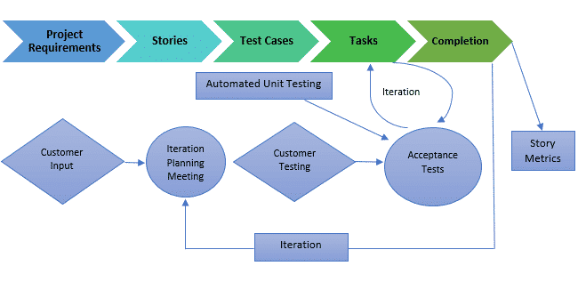
Software Development Lifecycle
Average
Why this methodology^{[1]} :
The system’s functionality is likely to change every few months.
The project might experience constantly changing requirements or work with customers who aren’t sure what they want the system to do.
The project team wants to mitigate project risk, especially around tight deadlines.
The project team is able to work closely with customers.
The project team wants to create automated unit and functional tests.
In XP, the planning game is held by the development team and stakeholders. It has two sessions: release planning and iteration planning. Customers and all developers in the team must participate. The planning game of XP is similar to the planning meeting of Scrum.^{[3]}
Scrum + XP
XP with Scrum model is built in each sprint for all the user stories. Scrum framework defines how work is specified and the process with which features are delivered uses XP engineering practices^{[5]}.
Both do quick planning (as short as 30 minutes to as long as a few hours)^{[5]}
They both have shippable code (at least) by the end of the iteration^{[5]}
They both require cross functional teams, meaning the team has everyone that’s needed to get the work done They are both highly social ways of working^{[5]}
Both have a role for process improvement and team mentorship^{[5]}
[4]
How do we blend Scrum with XP^{[6]} :
The XP teams ensure to deliver a working bug free system at the end of every iteration. User is asked to evaluate and provide feedback as a part of customer testing.
Scrum teams deliver working software at the end of every iteration. The Product Owner with the input from teams decides on the right time for the release depending on the completion of tasks as per user acceptance tests as shown in the picture [4].
[1] Wells, D. “When should I use Extreme Programming”( http://www.extremeprogramming.org/when.html ) [2] “Extreme Programming (XP) vs Scrum” Visual Paradigm. (https://www.visual-paradigm.com/scrum/extreme-programming-vs-scrum/ )
[3] “Extreme Programming Practice: Planning Game” ZenTao. 27 Nov 2020. (https://www.zentao.pm/blog/Extreme-Programming-the-Planning-Game-805.html )
[4] Sethi, N. “Agile Model Methodology of Software Development - Scrum, XP, DSDM, Lean” ElectricalFundBlog. 23 Oct 2018. (https://electricalfundablog.com/agile-model-methodology/ )
[5] “Do Scrum and Extreme Programming (XP) complement each other?” Quora. (https://www.quora.com/Do-Scrum-and-Extreme-Programming-XP-complement-each-other )
[6] Radhika Subramoniam, “What Is ScrumXP and How Does It Compare With Other Agile Frameworks” 16th March, 2021. (https://www.knowledgehut.com/blog/agile/scrum-xp)

Slide 24
Sprint Planning Overview
Simple
Created Jira Board for Project Management -> Created Epics for Personas -> Product Backlog -> Product RoadMap - >Sprint Backlog
User Story Selection: From the product backlog of 6 user stories we select the user story that will be worked on for the coming sprint based on prioritization.
Examine team availability^{[1]}: Our team of 3 developers and testers will be available for Sprint 1
Divide user stories into sub tasks: Each user story will have multiple sub tasks that will be worked on. We have subdivided 7 user stories into 28 subtasks. We have planned the sprint for a high priority user story in the Sprint plan section.
Estimate effort for user stories: We assigned story point to each user task and created sub-task for each phase in the extreme programming model including planning, analysis, design, development, testing and release.
Determine task ownership^{[1]}: Assign the tasks to the relevant team members.^{[1]}
Start sprint: Officially begin sprint and ensure team is on schedule through regular scrum meetings.
User Story Selected:
User story 5: DBA can Grant or Revoke access privileges for confidential information:
Decomposition:
1. Migrate data and set up user accounts on MySQL DB
2. Restrict access to privileged information by setting user roles and access privileges.
[1] Lucid Content Team, “How to run a sprint planning meeting” (https://www.lucidchart.com/blog/how-to-run-a-sprint-planning-meeting)

Slide 25
Sprint Plan
Simple
Sprint Goal: Migrate data and set up user accounts on MySQL DB
[1]
SPRINT BACKLOG
ID | User Story | Owner | Epic
SH-37 | Backup Data | Database Administrator | SH-9: Data Migration and User Account Setup
SH-40 | Import Excel files into MySQL DB | Database Administrator | SH-9: Data Migration and User Account Setup
SH-42 | Create User Accounts | Database Administrator | SH-9: Data Migration and User Account Setup
SH-46 | Bulk user account script | Database Administrator | SH-9: Data Migration and User Account Setup
SH-2 | Functional Testing of user accounts | Quality Analyst | SH-1: Testing Tasks
SH-3 | Integration Testing with IT Team | Quality Analyst | SH-1: Testing Tasks
Migrate data and set up user accounts on MySQL DB
Sprint 1
(Week 1)
Sprint 1
(Week 2)
Sprint 1
(Week 3)
Sprint 1
(Week 4)
Tasks
backup for all existing data
Import all data from different excel files and import in the database
Create user accounts with user id and password
Write script to create bulk user accounts
[1] Product Plan, “Sprint Backlog” (https://www.productplan.com/glossary/sprint-backlog/#:~:text=A%20sprint%20backlog%20is%20the,primary%20output%20of%20sprint%20planning. )
Timeline
Apr 18, 2022 - Apr 24, 2022
Apr 25, 2022 - May 1, 2022
May 2, 2022 - May 8, 2022
May 9, 2022 - May 15, 2022
Testing
Test Cases
Functional Testing
Integration Testing with IT team
Beta release testing

Slide 26
Prioritization
Simple
Criteria:
1. Quick wins (high impact, low effort)^{[1]}
2. Major projects (high impact, high effort) ^{[1]}
3. Fill-ins (low impact, low effort)^{[1]}
4. Thankless tasks (low impact, high effort)^{[1]}
User story 5 related to restricting access and setting roles and privileges is of highest importance as it will ensure that employees and users outside the organization do not have unauthorized access to the data.
User story 4 which allows data analyst to generate finance report is of lowest priority as this report can be generated even now and is not a blocker at the moment. It’s a nice to have feature.
High
US5
US1
Easy Wins
Major Projects
US2
Impact/ Value
US4
US3
US6
Thankless Tasks
Incremental
Low
Low
Effort
High
Priority Sequence:
US5 > US1 > US2 > US4 > US3 > US6
[1] Product Plan, “Action Priority Matrix” (https://www.productplan.com/glossary/action-priority-matrix/)

Slide 27
Relative Sizing
Simple
3 Factors that were considered:
Effort. How much work is required to complete this task?^{[1]}
Complexity. How difficult or complicated is this task?^{[1]}
Uncertainty. Do we know exactly what must be done to accomplish this task, or will we need to learn as we go?^{[1]}
Story Point Algorithm - T shirt sizing:
It typically starts with deciding the sizes: XS, S, M, L, XL ^{[1]}
A person is given one story at a time and asked to assign it a size. He/she must consider the effort, complexity, and uncertainty of the user story to size it.
Estimation is done based on the majority size picked by the team.
Repeat until each item is estimated.
Once all the items have been estimated, a mapping from t-shirt sizing to the quantitative aspect should be done.
On the basis of T-shirt sizing, we decided to give Story point as follows:
34 Story Points (XL): High Uncertainty, High Complex Task & High Effort.
21 Story Points (L): High Complexity & High Effort.
13 Story Points (M): Medium Complexity and High Effort
8 Story Points (S): Medium Effort, team has understanding of the task and some expertise in it.
5 Story Points (XS): Simple Task, team has experts and has performed such tasks in the past.
[1] Cotton, T. (2020) “How to Estimate Agile Stories: Introducing Relative Sizing”. LeanDog (https://www.leandog.com/blog/how-to-estimate-agile-stories-relative-sizing )
[2] ProductPlan.com, “Fibonacci Agile Estimation” (https://www.productplan.com/glossary/fibonacci-agile-estimation/)

Slide 28
Story Point Allocation
* change management not included in total
Simple
 | Design & Development | Testing | Change Management* | Deployment & UAT | Total
User Story 1 | 13 (M) | 8 (S) | 8 (S) | 5 (XS) | 26
User Story 2 | 5 (XS) | 5 (XS) | 0 | 8 (S) | 18
User Story 3 | 13 (M) | 8 (S) | 8 (S) | 5 (XS) | 26
User Story 4 | 5 (XS) | 5 (XS) | 0 | 8 (S) | 18
User Story 5 | 21 (L) | 21 (L) | 8 (S) | 8 (S) | 50
User Story 6 | 5 (XS) | 5 (XS) | 0 | 8 (S) | 18

Slide 29
Release Plan
Simple
Apr 18, 2022 - May 15, 2022
May 16, 2022 - June 12, 2022
June 13, 2022 - Jul 10, 2022
Sprint 1
Sprint 2
Sprint 3
Sprint 4 (2 Weeks)
Milestones
Beta 1
Beta 2
R1
Features
Migrate data and set up user accounts on MySQL DB
Restrict access to privileged information by setting user roles and access privileges.
Join data from different sources to get insights for delivery requirements
Release Sprint
Tasks
Create backup for most current data
Identify user roles and user permissions
Access Customer, Employee and Order data
Import data from excel into the database
Assign user roles to the created accounts
Identify columns required for analysis
Create user accounts
Grant access privileges based on roles.
Filter and transform data using DML queries
Script to create bulk accounts
Testing
Functional Testing
Functional Testing
Functional Testing
Performance
Testing
Integration Testing with IT team
Integration Testing with IT team
Integration Testing
Security
Testing
Beta Testing
Beta Testing
Beta Testing
Release
Change Management
Meet all release criteria
Documentation
Risk and Mitigation
[1] Racasan, M. (2021), “Agile Release Planning, Best Practices”, Zenhub.com, (https://blog.zenhub.com/what-is-a-release-plan-in-agile/)
[2] LucidChart, “Game Development and Release Template”, (https://lucid.app/lucidchart/b6daf8c4-59f4-4248-84fc-172e07c0b37c/edit?invitationId=inv_185a63a2-eb36-43fe-9619-a9852adcb5e1&page=0_0#)

Slide 30
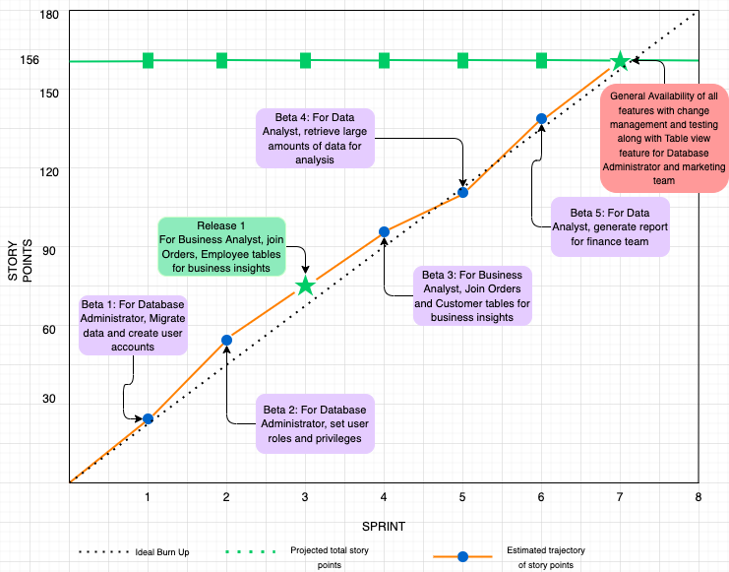
Burn up Chart
Simple
[1]
[1] Professor’s Lecture Note “MSIS2606 9 April 2022 AgileScrum.pdf”
[2] Everitt, J. (2022), ‘What is a Burn Up Chart?’, wrike.com, (https://www.wrike.com/blog/what-is-a-burn-up-chart/ )

Slide 31
Key Software Concept
Simple
Data Integrity
Data integrity refers to the accuracy, reliability, and consistency of stored data over its entire life-cycle ^{[1]}
The columns should match the excel attributes, so to prevent data inconsistency and ensure data integrity/quality
Coding Standard^{[3]}
Standard rule for documentation the source code
We will write scripts that can be optimized for the performance and use the coding rules consistently
Data Governance
A collection of policies, standards, and metrics that ensure the use of information in enabling an organization to achieve its goals ^{[2]}
We will be compliance with data regulations and using the data in a legal way
Code Review^{[3]}
In conformance to coding standards and logical errors or new/changed code
We will do the this action to check if there are any bugs and see if updating design is needed
[1] Dinu, C. (2021) “Data Integrity: What It Means and How to Maintain It” (https://heimdalsecurity.com/blog/data-integrity/)
[2] “What is Data Governance and Why Do You Need It” (https://www.talend.com/resources/what-is-data-governance/)
[3] Professor’s Lecture Note “MSIS2606 21 May 2022 Implementation”

Slide 32


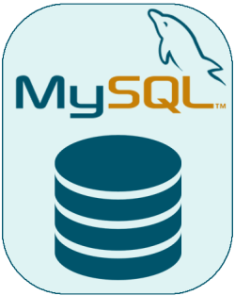

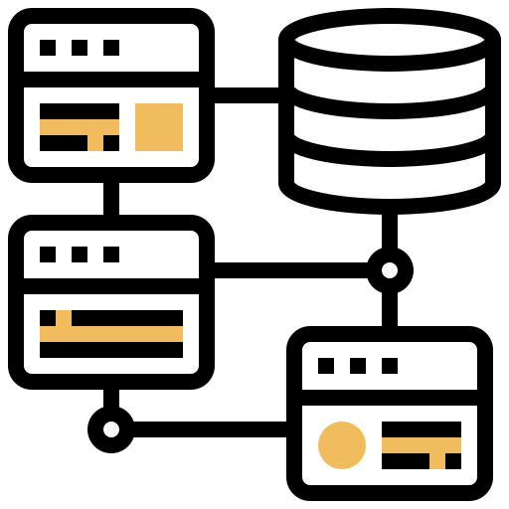
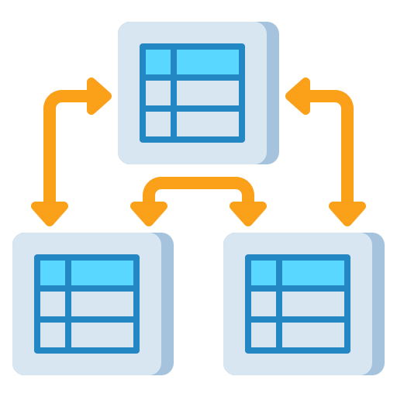



High Level Architecture
Simple
1
User Stories
Excel Data
^{[3]}
^{[1]}
2
Personas
Database
3
4
5
6
^{[3]}
7
^{[3]}
- Join tables
- Fetch large amounts
of data
- Gain business insights
^{[3]}
^{[3]}
^{[3]}
^{[3]}
Business Analyst
Data Import
^{[3}
Relational Modeling
- Extract large datasets
- Get financial and
customer data
- Provide insights
^{[2]}
Schema Design
Data Retrieval
Joining tables
Business Insights
Data Analyst
Excel Data: Originally our data was stored and maintained in Excel.
Database: Our choice of OSS is MySQL which is where we will import, store and maintain our growing database.
Schema Design: The schema design will determine the Primary Keys in a table and how each table will be connected to other tables in the database.
Relational Modeling: Relationships between tables will help in join queries and accessing data with ease.
5. Data Retrieval: After relationships between tables have been established, users can retrieve data from the tables for business purposes.
6. Joining Tables: By joining multiple tables, users such as our Business Analysts and Data Analysts will be able to draw valuable business insights.
7. Business Insights: The business insights can then be presented by our users to stakeholders and managers.
[1] Slidego (https://slidesgo.com)
[2] “Discover the Advantages of MySQL Design" (https://webuilddatabases.com/mysql-design/ )
[3] FlatIcon (https://www.flaticon.com )

Slide 33



Low Level Architecture (Join Query)
Simple
Customer Data
^{[3]}
Data Retrieval
Database
Employee Data
^{[3]}
Excel Data
^{[2]}
^{[3]}
^{[3]}
^{[1]}
^{[3]}
Data Import
Data Retrieval
Query Results
Business Insights
Join Query
Orders Data
^{[3]}
Data Retrieval
[1] Slidego (https://slidesgo.com)
[2] “Discover the Advantages of MySQL Design" (https://webuilddatabases.com/mysql-design/ )
[3] FlatIcon (https://www.flaticon.com )

Slide 34
Why Join Query Architecture?
Simple
The Join Query is an important MySQL functionality for the users such as Business Analysts and Data Analysts that was previously not available to them in Excel.
The preliminary steps in order to start performing queries in MySQL include having a backup created for our data before the move, designing the schema, importing data from Excel to MySQL and determining user access privileges.
After these steps are completed, the user(Business Analysts/Data Analysts) can begin fetching data from the database. For the diagram depicted(follows User Story 1), the Business Analyst, Savannah Walker fetches data from three tables: Customer Data, Employee Data and Orders Data.
Retrieving this data and then joining these tables where Employee Type = Delivery Personnel will give the user the results that shows which locations have how many orders and the locations with higher volumes of orders can be identified.
This will allow Savannah to presents insights such as identifying where our Delivery Personnel need to be increased which would result in faster deliveries and increased Customer Satisfaction scores.

Slide 35
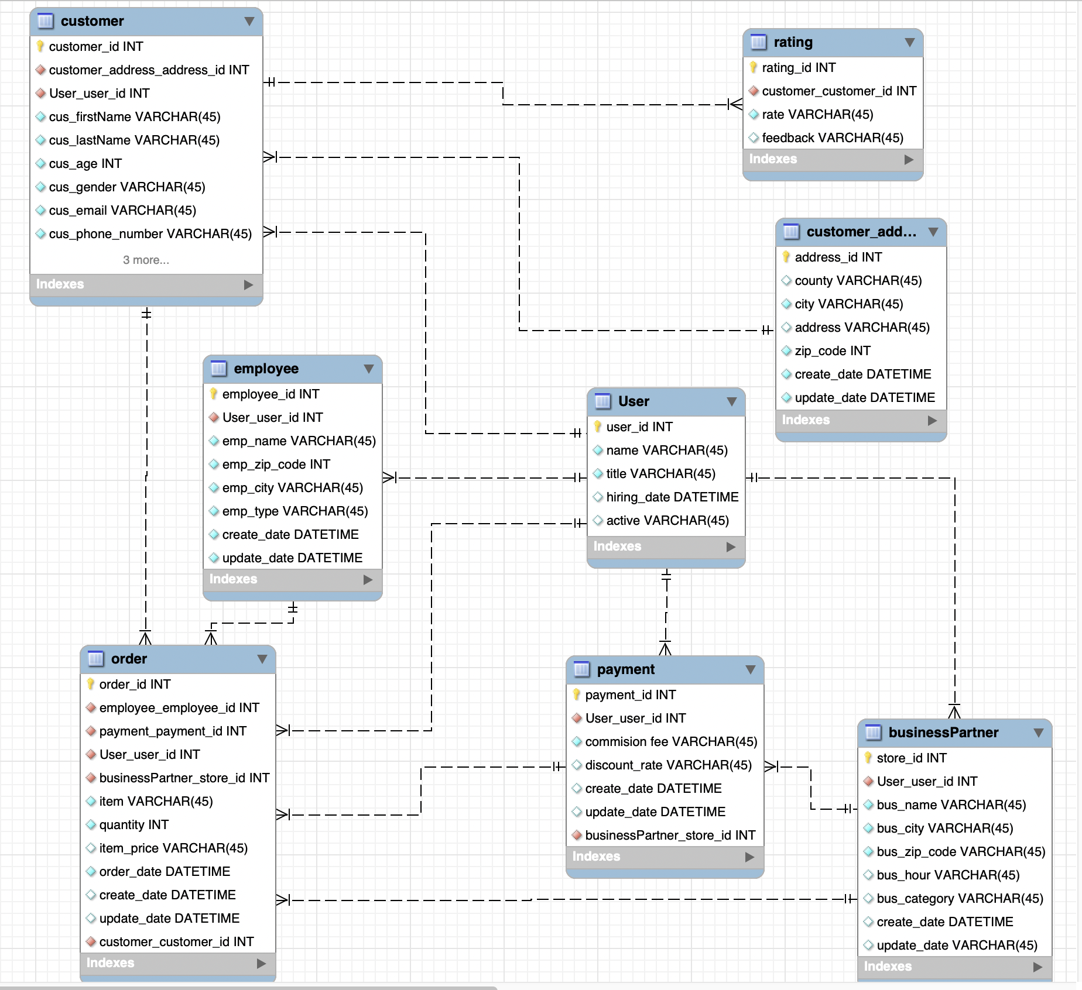
High Level Design - ER Diagram
Simple
The overall ER-diagram is showing the tables and the relationship among them which all of our personas can extract data of what they need by querying the corresponding tables and columns.
Employee table is created for the different personnel including delivery and the user table is created for business, data analyst and database administrator.
With customer, order or employee tables given, business analyst is able to join them together to get the result to do the analysis for business insight for user story 1 and 2. For example, joining customer and order tables on customer_id key and joining order and employee tables are generating the rows of the customer information with the order they make and the corresponding employee who deliver the order.
Likewise, with customer, businessPartner, order and payment tables given, data analyst is able to make trigger to generate transactional report and get the output for business partner sales performance. Also, database administrator can create view with joining the necessary tables.
[1]
[1] MySQL Workbench (https://dev.mysql.com/downloads/mysql/)

Slide 36
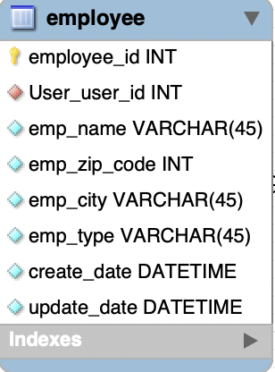
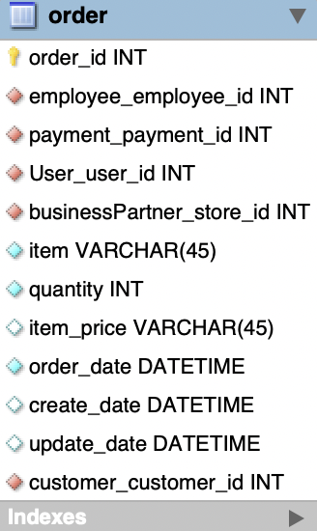
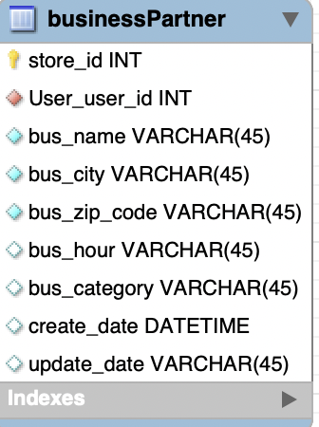
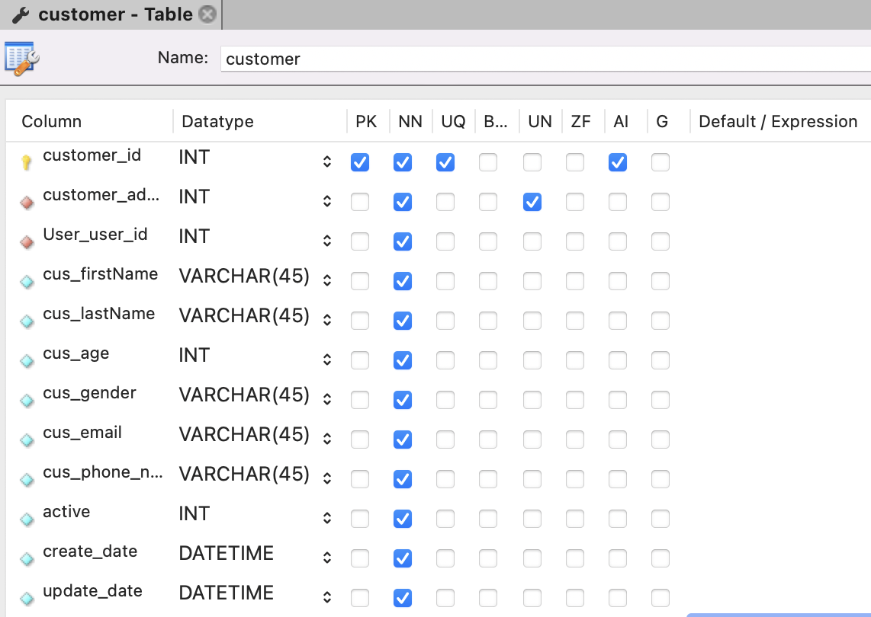
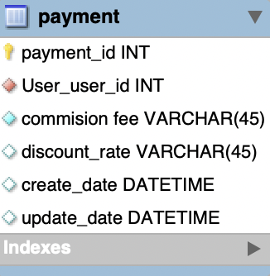
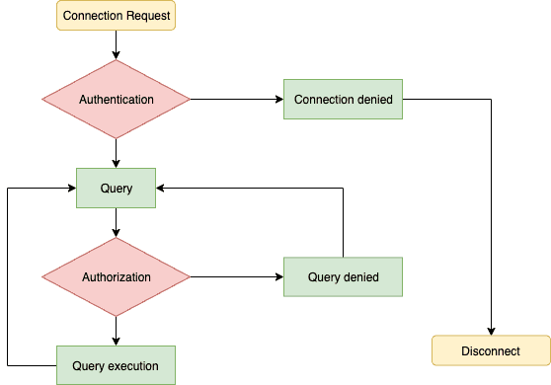
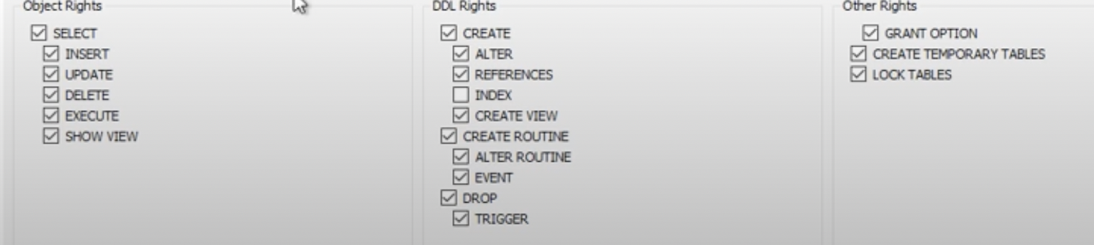
Low Level Design
Table Columns/Attributes Design
Average
With joining with other tables:
User story 1 can be analyzed by emp_name and emp_zip columns from employee table
User story 2 and 6 can be analyzed by columns provided on customer table
User story 3 can be analyzed by item_price, quantity from order table and commission fee from payment table
User story 4 can be analyzed by columns from businessPartner table
[3]
User account management for user story 5
Permission to Business Analyst and Data Analyst with limited access (pic shown on the left bottom with the list of optional access that we can design)
Permission to DBA with full access
If analysts want to access the databases, they would need to enter correct authentication information; otherwise, the system will deny their access and the connection will be failed.
[1]
[3]
Example - customer table (columns/attributes on the rest of the tables are having the similar design besides the column names are different)
NN: not null - some of the attributes can’t be null as analysts need the data for analysis
AI: autoincrease - system is adding customer automatically if there is a new one
Column date: represent the create and update time
Column active: represent if the account is active
[2]
[1] “Beginners Guide to MySQL User Management“ (https://www.thegeekdiary.com/beginners-guide-to-mysql-user-management/)
[2] TechBrothersIT (2018) “How to create user and provide permission by using MySQL Workbench - MySQL DBA Tutorial” (https://www.youtube.com/watch?v=a1QgxTxftDY)
[3] MySQL Workbench (https://dev.mysql.com/downloads/mysql/)

Slide 37
Test Goals
Test Strategy
Practices for Testing:
Simple
To ensure that the functional requirements satisfy the user(persona) needs completely and are delivered to them at the right time to enable the personas to contribute in the revenue of the company^{[3]}.
To ensure that there is no customer dissatisfaction, all internal found defects and ease of use problems to be addressed immediately^{[1]}.
For data security, testing at the firewall level is needed to prevent any kinds of data leak.
Identify testable requirements^{[2]}. Identify the scope and purpose of testing before starting the test process.
Customer requirement^{[2]}. Each test case should be written keeping the client’s requirements in mind.
Management and review of test cases^{[2]}. Each test case must have a unique name to help classify, track, and review test cases at later stages. All test cases will be reviewed internally and with CSPO. All the bugs will be reported on JIRA.
Test cases should be maintainable^{[2]}. If requirements change, a tester must be able to adjust a test case.
Timely testing. Testing will be done at regular intervals both in the day and night to ensure that all newly built code is monitored.
Testing tools.Automation testing will be done using SQL.
Gray-box testing: Testing with some knowledge of architecture and high-level design^{[3]}
Tests should be traceable to requirements^{[3]}
Tests to be developed before testing begins^{[3]}
Testers not same as developers^{[3]}
Dev:Test Ratio - 4:1 - developers responsible for unit testing; and other testing done by specialised testers. Ratio is high as automated scripts are leveraged for testing^{[3]}
Tests should run to completion even when facing defects^{[3]}
Perform manual testing and automated testing concurrently^{[3]}
[1] Pradeep Parthiban, “7 Reasons Why Software Testing is Important” (14th Apr. 2021), (https://www.indiumsoftware.com/blog/why-software-testing/)
[2] Altexsoft “11 Ways to Improve Software Testing through Planning, Work Environment, Automated Testing, and Reporting” (feb. 2021) https://www.altexsoft.com/blog/engineering/software-testing-qa-best-practices/
[3] Professor’s notes “MSIS2606 28May2022 Testing.pdf”

Slide 38
Testing Methodology
Unit Testing Plan
Beta Testing Plan
Integration Testing Plan
Functional Testing Plan
Security Testing Plan
Simple
Developer is expected to verify that the modified code is being tested and results report should be attached to all commits and Jira ticket^{[1]}
Ex: If null values are handled in a certain way in the main table, an original copy of the previous table consisting of null values must be recorded, and a report of before and after values must be attached to it’s JIRA ticket as a part of unit test report
Data from the new database is collected and samples from the functional and regression test cases are executed with similar conditions as used by the personas
Inhouse personas are involved during this testing done by the test team and feedback from users for interaction with the system and evaluation on ease of use and intelligibility is recorded^{[2]}
Defects from Beta testing are reported to be rectified in the next Beta test cycle
Once the pipeline for cleaning, manipulation, analysis and visualization are implemented, we need to verify the pipeline works as expected on the same data set in one go with 2-3 sub components^{[1]}
Incorporate regression testing with automated scripts for both BAT and FAT^{[1]}
Basic Acceptance Testing: Identify each component (cleaning, manipulation, etc.) level subset of automated cases for BAT^{[1]}
Final Acceptance Testing: Component level complete automated scripts for features functionality is verified^{[1]}
Decompose each user story to test acceptance criteria for each of them
Data Integrity testing: Migration of data from one place to another often results in data duplicacy and redundancy. Comparing data at the before and after location to test it’s integrity is of utmost importance.
Before rectifying the data integrity, a report on before and after data is attached to it’s JIRA ticket.
Data migration testing takes place to ensure that there is no data leak
‘White Hat’ Hackers testing: To prevent any leakage of data, we outsource a team of hackers to check the safety of data^{[1]}
We place the wirefalls between the server and users to enhance the security.
[1] Professor’s notes “MSIS2606 28May2022 Testing.pdf”
[2] Wayne Yaddow, “Component and Integration Testing for DWH/BI Projects” Dec 14, 2018 (https://www.tricentis.com/blog/component-integration-bi-datawarehouse-testing/)

Slide 39
System Testing
System Testing Plan
Performance Testing
Scalability Testing
Upgrade Testing
Simple
Complete dataset is used and all the triggers are performed using black box data testing
Both manual testing (ad-hoc) and automated testing is performed
Performance testing to verify the effectiveness and speed of the system^{[1]}
Stress testing to see how system works under load^{[1]}
Upgrade tests Verify upgrade between beta release and releases^{[1]}
Used to test the speed of computation when a large data-set is used^{[3]}
Success metrics for latency, data storage, memory usage, processor usage are defined and measured^{[3]}
Used to detect load time as decompression and compression cycles may cause the application and services to take more time than usual to start^{[3]}
Measures performance of a system when number of requests are scaled up or down for each type of data frames (customer, order, product/food)
Ensure that system can handle increase in data volume^{[2]}
Ensures that analysis is correct when we scale the data^{[2]}
Record which part of application stops scaling and identify the reason behind it^{[2]}
Record reliability and resource usage under each scaled condition^{[2]}
Used to ensure that a particular update can be installed on already existing system^{[4]}
Done before each Beta or major release
Ensure if the system will continue to work after upgrade to new release and additional functionality is usable^{[4]}
[1] Professor’s notes “MSIS2606 28May2022 Testing.pdf”
[2] Thomas Hamilton, “What is Scalability Testing? Learn with Example” Apr 23, 2022 (https://www.guru99.com/scalability-testing.html)
[3] Malcolm Ridgers, “Performance Testing on Big Data Applications” (https://www.kdnuggets.com/2020/08/performance-testing-big-data-applications.html )
[4] Perforce Test Management, “Upgrade Testing Vs Installation Testing” Sept 17, 2009 (https://www.perforce.com/blog/alm/upgrade-testing-vs-installation-testing )

Slide 40
Sample Functional tests for User Stories
Average
User Story 1
Database should contain the Customer, Orders and Employees tables.
Data for the past month should be available.
When the query is run, it should display the results or errors in the query, if any.
Ensure that customer satisfaction of customers in these areas is above 7 on a scale of 10.
Success : Customer satisfaction rate has increased by 2 points^{[2]}
User Story 2
There must exists SQL based views for top 1000 customers (VIP) by number of orders placed by them in the previous month.
Orders which are cancelled should not be a part of the top 1000 customer dataset.
The view must include the Customer’s Email address, Contact Information and Location.
SQL Procedure to find out 15 zip codes which have the lowest number of orders placed.
SQL Script calculating the average of the top 1000 customer’s rating in the past month.
Success : Increase customer’s 6 month retention rate by 15%.^{[2]}
User Story 3
The transactional report must have the sales data including meals fee and shop/restaurants commission fee.
The report must display sales data based on the time frame (can be quarterly, monthly, yearly) requested by the finance team.
The report should include dates, and customer and business partner names without null values.
The report should have amount great/less than 0.
Success : Reduce expense and effort by ~$10,000 for data analyst on reporting*
User Story 4
The row of the dataset must be able to exceed 10 million rows because Excel’s current limitation is 1048576 rows.
The order must contain the shop or restaurant name, cuisine/category of food, restaurants’ location/distance, business hours, item price.
The order must have the sales from largest to smallest amount and be filtered by cuisine and location.
Success : Increase business growth by 0.5%^{[2]}
User Story 5
Employees with low level authorization(read-only) must not be able to perform UPDATE, DELETE queries.
Incorrect password must prevent access to the database.
Connection to the database must be end to end encrypted.
DBA must be able to create roles and GRANT privileges to them
DBA must be able to REVOKE access for objects in the database
Success : Reduces the risk of data breach which can cost a company $4.24 million dollars.^{[1]}
User Story 6
The data of customer demographics should not include null values.
The dataset should include Names, addresses, gender, age and location of the customers; it should also have the Transaction history from last quarter to calculate the total order cost for a cohort in a location.
View should have sorted information on total spent from largest to smallest grouped by location and age.
Success : Increase in revenue growth by 2.5% with marketing improvement.^{[2]}
[1] IBM (2021), Cyber Attacks (https://spanning.com/blog/cyberattacks-2021-phishing-ransomware-data-breach-statistics/#:~:text=According%20to%20the%20Identity%20Theft,in%202020%2C%20which%20was%201%2C108)
[2] HungryMile_FinalReport User Story Slide 19 - 24
Notes:
* Data analyst spends 8 hours * $70 * (12(monthly report)+4(quarterly)+1(yearly))

Slide 41
Success Metrics for
Testing Strategy & Testing Methodology
Simple
Criteria | Goal
Query result with Delivery driver data | Able to identify areas to increase delivery personnel
Query result of most popular customers | Retrieve and analyze data of top 1000 VIP customers
Transactional report should be generated | Retrieve quarterly, yearly sales data
Store large volumes of order data | Able to view sales and apply filter
Database permissions | Able to GRANT and REVOKE access
View with Customer demographic information | Able to filter target audience and calculate order cost
Success Metrics for Testing
Total number of test cases passed.^{[1]}
Total number of cases failed. ^{[1]}
Blocked test cases^{[1]}
Total number of bugs raised^{[1]}
Priority of the bugs raised^{[1]}
Number of rejected bugs^{[1]}
Number of duplicate bugs raised^{[1]}
Number of bugs raised after releasing (in prod)^{[1]}
Static analysis report for code coverage^{[1]}
Number of test cases automated^{[1]}
[1] Tricentis Team (2016)“Essential testing Metrics”, Tricentis.com, (https://www.tricentis.com/blog/64-essential-testing-metrics-for-measuring-quality-assurance-success/)

Slide 42


Title
Change Management
Stakeholder Engagement
Performing a Stakeholder analysis exercise to understand user requirements(eg. time to move from Excel to MySQL).^{[1]}
Training for our Database Administrators
Getting our Database Administrators MySQL Certified with credentials via the MySQL Support Services.^{[2]}
Incorporating User Feedback
Collecting, analysing and incorporating User Feedback during the testing and beta tests.^{[1]}
Training for our Data/Business Analysts
Data Analytics script training in MySQL will be provided our Data Analysts via the MySQL Training Services.^{[2]}
[1] “6 components of Change Management to set you up for success” R10. (https://www.r10.global/blog/6-components-of-change-management-to-set-you-up-for-success )
[2] HungryMile_FinalReport Slide 8

Slide 43

Bug Management
Simple
Bug will be defined on setting up schema, tables, table attributes or user account management
For instance, if joining tables are not successfully processed, then the bug will be categorized as a find bug
Bug Tracking^{[1]}: using Jira to track bugs and ensure each bug is tracked on each stage of testing phase
Support bugs requests
Label and update the states of bugs: open, closed, pending
Update of new changes including timestamps and updater’s name
Identify a bug’s severity and priority
high/low severity: significant failure (S0)/can be fixed later
high/low priority: major business impact (P0)/minor business impact
When closing to a release, checking if bug fix rate is higher than bug find rate^{[1]}
Improve the fix rate if the rate is low by fixing the bugs
move low severity and priority bugs to the next release on a bug ‘backlog’
decide if all of the bugs need to be fixed or if some of them can be moved to the next release
When the bugs are fixed, do the code review first and then commit the code to the source code repository^{[1]}
[1] Professor’s Lecture Note “MSIS2606 14-21 May 2022 RelBranchProjMgmt [Autosaved]”

Slide 44
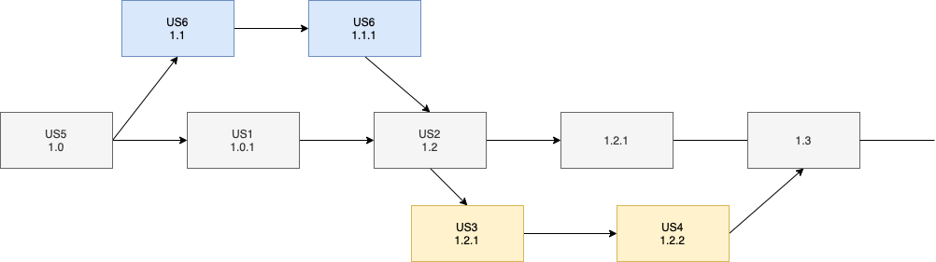
Branch Management
Simple
[1]
[3]
Creating new changes should be done in a new branch so that main branch is not affected^{[4]}
[3]
[3]
[2]
Backups should be made after each merge
Stress testing of new versions conducted before merging of branches^{[1]}
BAT after every minor version^{[1]}
[1] Professor’s Notes “MSIS2606 14-21 May 2022 RelBranchProjMgmt.pdf”
[2] Diagrams.net (https://app.diagrams.net)
[3] FlatIcon (https://www.flaticon.com )
[4] “How to make SQL database version control safer with branches” ApexSQL (https://solutioncenter.apexsql.com/how-to-make-sql-database-version-control-safer-with-branches/)

Slide 45
Release Criteria & Checklist
Simple
Checklist
100% of functional test cases have passed^{[1]}
95% of the non-functional test cases have passed^{[1]}
No P0 and S0 bugs are outstanding^{[2]}
All planned user stories have been done as per the acceptance criteria^{[2]}
Load tolerance of the application after migration to MySQL is 1 sec.^{[1]}
All technical documentation for user stories and training is completed
Release notes are defined and documented
3 days before release no new bugs will be fixed in the release.^{[2]}
Code coverage percentage for release features is 50%
100% of acceptance test cases have passed.^{[2]}
Release checklist is available
All relevant users have been notified about the release
Change management is complete
Items
Create backup for data (RC: Pt. 13)
Schema design is complete
Relationships between tables established (RC: Pt. 4)
Employees assigned “roles” and access privileges determined(RC: Pt. 4)
Security features in place
Employee Training Sessions (RC: Pt. 13)
Import data from Excel to MySQL
Testing completed (RC: Pt. 1,2,3,5,10)
Release communications sent to Employees (RC : Pt. 12)
Stakeholders sign off the release (RC: Pt. 6,7)
[1] Montvelisky, J. (2008) “Release Criteria” QABlog (https://qablog.practitest.com/release-criteria-defining-up-front-when-the-product-will-be-ready-to-be-released/)
[2] Professor’s Notes (2022) MSIS2606 14-21 May 2022 RelBranchProjMgmt [Autosaved].pdf
RC: Release Checklist

Slide 46
Average
Return on Investment(ROI)
 | FY 2022 (Current) | FY 2023 (Next)
Office 365 Subscription ^{[1]} | $7200 | $7200
Cloud hosting fee^{[2]} | $870 | $925
Development fee | $317,500 | $0
Maintenance fee | $0 | $127,000
Training^{[3]} | $40,000 | $40,000
Total Cost / Year | $365,570 | $175,125
Expected Revenue* | $28,500 | $177,000^{[4]}
Net Return | ($337,070) | $1,875^{[4]}
Revenue | $5.9M | $6.3M
ROI | -92.20% | 1.07%
While the database transition is taking place HungryMile aims at increasing the revenue by 0.5%
Once we completely move to MySQL, we estimate an increase of 3% in the revenue^{[4]}.
ROI is expected to increase by 93% from current to next year.
ROI = Expected Revenue - Total Cost
Total Cost
[1] “Microsoft 365 for business”, Microsoft (https://www.microsoft.com/en-us/microsoft-365/business?ms.officeurl=business%3fms.officeurl%3dbusiness&rtc=1#coreui-heading-hiatrep)
[2] ”Google Cloud Pricing Calculator”, Google (https://cloud.google.com/products/calculator#id=undefined)
[3] “Coursera for business”, Coursera (https://www.coursera.org/business/compare-plans)
[4] User Story, Slides 24- 29
Development fee includes the salary of 5 people working on the project for 6 months including burden cost
Maintenance fee includes the salary of 2 employees in ‘23 including burden cost.
Notes:
*Expected Revenue is the expected increase in revenue due to the database transitioning.
for FY 2022 Expected Revenue= $28,500 (0.5% of 5.7M which was 2021 Hungry Mile’s total revenue)
for FY 2022 Expected Revenue= $177,000 (3% of 5.9M which is 2022 expected Hungry Mile’s total revenue)

Slide 47

Title
Return on Value(ROV)
Increased Productivity
Work off central database Less time looking for current sheet Backup will reduce time to get database running^{[1][2]}
Customer Satisfaction
Reduced customer complaints
Increased customer retention
Consistent Delivery
High availability of database Limiting system downtime and providing high quality service.^{[3][4]}
Faster Response
High transaction speed Serve 300,000 simultaneous customers^{[5]}
Security
Authentication, Firewall, Encryption ^{[6][7]}
[1] “Chapter 7 Backup and Recovery”, MySQL (https://dev.mysql.com/doc/refman/8.0/en/backup-and-recovery.html)
[2] “GCI Achieves Carrier-grade Uptime and Slashes IT Costs with MySQL Enterprise Edition”, (https://www.mysql.com/why-mysql/case-studies/gci-carrier-grade-uptime-mysql.htm)
[3] “LINE Enhances Database Availability, Scalability, and Security with MySQL”, (https://www.mysql.com/why-mysql/case-studies/line-database-availability-scalability-security-mysql.html)
[4] “France Billet Stakes Online Ticket Sales on High Availability of MySOL Enterprise Edition”, (https://www.mysql.com/why-mysql/case-studies/france-billet-high-availability-mysql-enterprise-edition.html )
[5] “Big Fish Games Triples Database Performance with MySQL Query Analyzer”, (https://www.mysql.com/why-mysql/case-studies/big-fish-games-triples-performance-with-mysql-query-analyzer/ )
[6] “Digital14 relies on MySQL Enterprise Edition for Enhanced Security”, MySQL, (https://www.mysql.com/why-mysql/case-studies/digital14-relies-mysql-security.html)
[7] “Chapter 6 Security”, MySQL (https://dev.mysql.com/doc/refman/8.0/en/security.html)

Slide 48
Simple
Success Metrics
Criteria | Goal
Query Performance | 200 msec^{[1]}
API Response Time | 1 second
User and Query Conflicts^{[2]} | Prevent inserts and updates from occurring while a read query is running
Database Connections^{[4]} | Automatic closure of db connections after retrieving query
Bugs | No High Priority & High Severity outstanding bugs
Project Delivered Within Budget^{[3]} | < than the proposed budget: $648,070
Project Delivered on Time^{[3]} | Dec 28, 2022
Improved productivity^{[3]} | 80% time analyzing data and 20% time gathering data^{[3]}
[1] Linoff, G. Stackoverflow. 26 Jun 2014. (https://stackoverflow.com/questions/24429350/what-is-a-good-healthy-mysql-query-execution-time )
[2] Habib, O. “Top 6 Database Performance Metrics to Monitor in Enterprise Applications” AppDynamics. 23 Dec 2015. (https://www.appdynamics.com/blog/engineering/top-6-database-performance-metrics-to-monitor-in-enterprise-applications/)
[3] “Data Warehouse Success Measures” EWSolutions. 02 Jun 2021. (https://www.ewsolutions.com/data-warehouse-success-measures/)
[4] Key Database Performance Metrics You Must Track Regularly” Ubiq Bi. 10 Aug 2020. (https://ubiq.co/analytics-blog/key-database-performance-metrics-must-track-regularly/)

Slide 49
Simple
Risk Management
 | Impact Severity | Control / Mitigation Strategy | Residual Risk
Tech risks
Data loss risk | Catastrophic | Automated daily backups Automated weekly full backup^{[4]} | Critical
Extended downtime risk | Catastrophic | Redundant server | Critical
Data corruption risk | Catastrophic | Automated daily backups Automated weekly full backup^{[4]} | Critical
Management Risks
Potential workforce shortage | Moderate | Incentivize workers with benefits^{[1]} Implement Reskilling and Upskilling Initiatives^{[2]} | Low
Time management | Moderate | Close monitoring of roadmap Setting shorter sprints | Low
Cost budgeting/control | Critical | Sticking to the planned budget Record costs and calculate metrics^{[3]} | Moderate
[1] “5 ways to navigate the labor shortage and mitigate risk”, Liberty Mutual Insurance, Jan 28, 2022, (https://business.libertymutual.com/insights/5-ways-to-navigate-the-labor-shortage-and-mitigate-risk/)
[2] “How to Manage a Staffing Shortage.” Monster.com, 17 Dec. 2021, (https://hiring.monster.com/resources/workforce-management/employee-retention-strategies/how-to-manage-a-staffing-shortage/ )
[3] “How to Manage Cost in Project Management.” Planview.com, 24 May 2021, ( https://blog.planview.com/manage-cost-project-management/)
[4] “Chapter 7 Backup and Recovery”, MySQL (https://dev.mysql.com/doc/refman/8.0/en/backup-types.html )

Slide 50
Simple
Software Disaster
Software Disaster
What could be the reasons for the software disaster? ^{[1][2]}
External threats like malware and viruses
Sudden power outages
Programming failures
a user inadvertently deletes critical data
a malware attack encrypts or destroys data
a power failure causes data to become corrupted
an earthquake destroys physical storage infrastructure
software corruption leads to data loss or lack of availability
a rogue employee steals a physical storage device.
Hardware failures
Corruptions in the database
Manual errors
Issues in SQL architecture
Why do we need a software disaster strategy?
To protect against data loss and service disruptions we need to implement a disaster recovery strategy that minimizes downtime and ensures the safe recovery of any affected data.
The primary goal of a disaster recovery plan is to ensure business continuity if disaster strikes.
We have determined the following three metrics for software disaster strategy in our company:
Recovery Time Objective (RTO)
Recovery Point Objective (RPO)
Recovery Level Objective (RLO)
Our software disaster strategy
Regular Database Backup
We have automated daily backups and automated weekly backup in place apart from differential database backup which takes places every minute. (User Story 5)
SQL Server replication
Better approach while copying and distributing data & database objects from one database to another and then keep those databases synchronized. (User Story 5)
Log shipping
Standby databases will be available for read-only queries
Fail-over Clustering
recovery through geo-clustering^{[2]}
[1] Robert, S. “How to manage disaster recovery in SQL Server” SearchDisasterRecovery, 25 Feb. 2022, (https://www.techtarget.com/searchdisasterrecovery/feature/How-to-manage-disaster-recovery-in-SQL-Server )
[2] Sharma, M. “How to plan for SQL Server Disaster Recovery?” Data Recovery Blog 14 Apr. 2022. (https://www.nucleustechnologies.com/blog/sql-server-disaster-recovery-plan/)

Slide 51
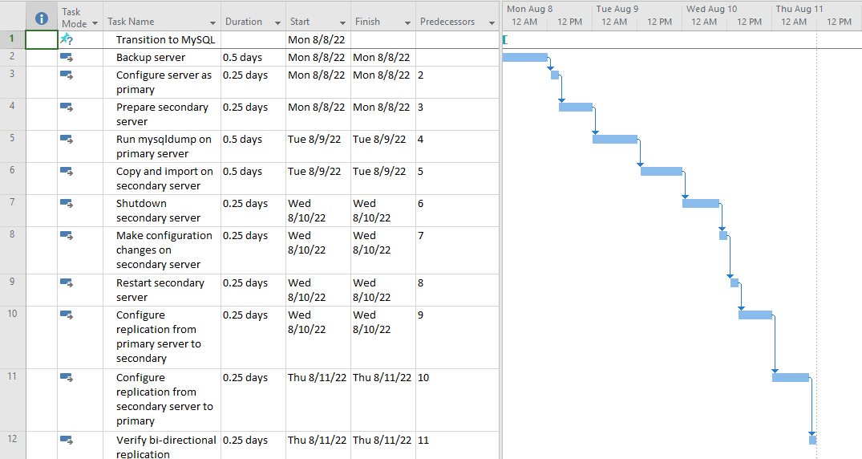
Critical Risk - Extended Downtime
Simple
Mitigation: Create and Maintain Redundant Server
Business continuity^{[2]}
Allow for business to continue operations in the event primary server is down
[1] Cooke, A. “MySQL Replication for Redundancy” 06 Mar 2019. Krystal. ( https://labs.k.io/mysql-mariadb-replication-redundancy/)
[2] Kirk, C. “Backups and Redundancy: Why Your Business Needs Both” 16 Jan 2020 (https://www.lightedge.com/blog/backups-and-redundancy-why-your-business-needs-both/)

Slide 52
Title
Intellectual Property
Licensing information for MySQL
MySQL Community Edition(Version 5.6.46 and later) is released under version 2 of the GNU General Public License(GPLv2).^{[1]}
This version of MySQL is distributed with certain software and libraries including but not limited to OpenSSL, MySQL C API client library and more.^{[1]}
Since MySQL is licensed under an Open Source License, we can obtain a copy of the applicable source code at http://www.oracle.com/goto/opensourcecode. ^{[1]}
[1] MySQL, “Licensing Information User Manual(MySQL 5.6.46 and later)”(https://downloads.mysql.com/docs/licenses/mysqld-5.6-gpl-en.pdf)

Slide 53



THANKS!
Title

Slide 54
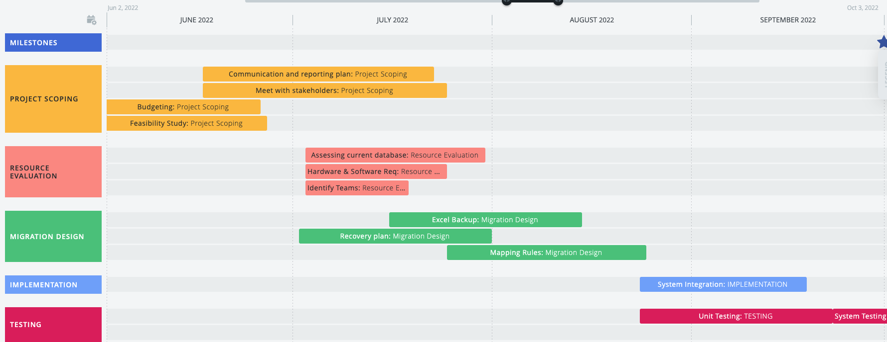
PROJECT PLAN
Backup
^{[1]}
[1] Roadmunk (https://app.roadmunk.com/ )

Slide 55
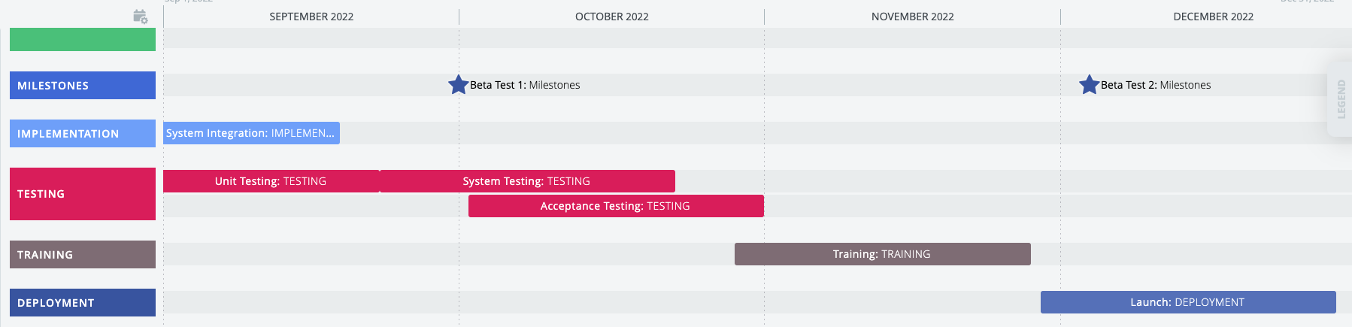
PROJECT PLAN.. contd
Backup
^{[1]}
[1] Roadmunk (https://app.roadmunk.com/ )

Slide 56
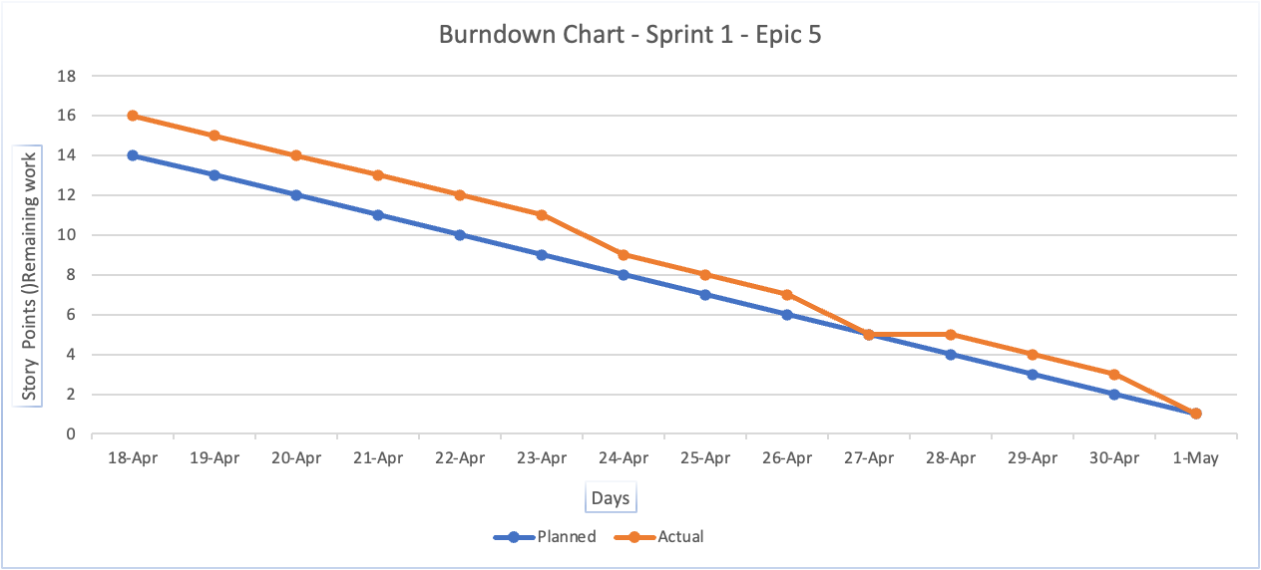
Estimated Burndown Chart
Backup
[1] Professor’s Lecture Note “MSIS2606 9 April 2022 AgileScrum.pdf”

Slide 57
Scrum Meeting Notes
In order to ensure all progress toward our Sprint Goal and monitor how progress is trending toward completing the work in the Sprint Backlog, our team decided to have Scrum Project meeting everyday from 2:30 to 3:00 pm. Here is the template for our meeting notes:
Backup
Date | Notes | Participations
4th April 2022 | Scrum project timeline and team roles assignment. | Everyone
5th April | Research on open-source tools | Everyone
6th April | Shortlisting open-source tools | Everyone
8th April | Review of chosen open-source tool with professor | Everyone
9th April | Evaluated methods to apply OSS to our project | Everyone
10th April | Draft Report preparation | Everyone

Slide 58
Daily Scrum Meeting Notes (Week 1)
(April 4th 2022 to April 9th 2022)
Backup
Question | Monday | Tuesday | Wednesday | Thursday | Friday | Saturday
Progress made on the previous day | Assigned the roles for the each member and came up with group name suggestions | Successfully narrowed down to a business idea | Conducted research regarding all open-source platforms | Corroborated technical research on the OSS’s application for our project | Attained some knowledge on technical aspects of the OSS, concepts like upstream and downstreams, ROV and ROI of our project. | Documented the first draft of the OSS project
Goals planned for today | Research for the business hypothesis that supports a social cause | Find an internal project within the business to work on, choose an OSS that makes a difference in that project | To shortlist top three OSS and come up with problem statement, it’s solution and a detailed business hypothesis | To identify objectives and principles, technical functionality of the project | To start working on proposal document and assemble all the information including ROI and ROV. | To get clarification on technical concepts from the lecture and professor
Obstacles faced | To understand that our OSS project was a part of the business hypothesis and not the entire business itself | Choosing an appropriate OSS and incorporating it into that project | The OSS chosen at first was not the best choice. After having a detailed discussion with the professor, a new OSS was chosen | Application of technical functionality of the OSS on the project was a challenge | Implementation of MySQL into the project, justification of business aspects like number of employees, revenues, ROV and ROI. | To find a correlation between these technical aspects with our project

Slide 59
Daily Scrum Meeting Notes (Week 2)
(April 11th 2022 to April 16th 2022)
Backup
Question | Monday | Tuesday | Wednesday | Thursday | Friday | Saturday
Progress made on the previous day | Modified the ROI and ROV more accurately, looked up some tutorials on JIRA | Work was divided equally among all teammates | Finalised on the personas, SDLC models. Key software concepts were introduced | Understood key software concepts, justified the choice of SDLC model and its implementation. Persona & user story for Business Analyst was written | We were able to identify more user personas and their corresponding user stories | Updated the documentation of the draft report
Goals planned for today | To get into the details of the draft report and start working on JIRA. | Sandra - User personas, company hypothesis Nafen & Nivedita - OSS, software concepts Tanu & Anthony - ROI, ROV, SW disaster Everyone - User stories Miloni - SDLC, Team velocity & sizing | To understand key software concepts in details. Justify the chosen SDLC model and incorporate its blending. Sketch a persona for Business Analyst | To identify other user personas and related user stories | To identify risks and mitigation for the project, SDLC pros and cons | To get feedback on personas and user stories from the lecture and professor
Obstacles faced | Some features of JIRA were difficult to grasp on. | Type of SDLC to be used and Software concepts | Difficult to sketch more user stories matching the personas | User stories needed to be more specific | To work more closely keeping the software concepts in mind | Incorporate the feedback changes

Slide 60
Daily Scrum Meeting Notes (Week 3)
(April 18th 2022 to April 23rd 2022)
Backup
Question | Monday | Tuesday | Wednesday | Thursday | Friday | Saturday
Progress made on the previous day | Risks and mitigation for the project. SDLC pros and cons. Work more closely with software concepts. | Worked on sprint 1 backlog, JIRA user stories, software concepts. | Worked on architecture, burn up and assembled the data together. | Understood key software concepts, justified the choice of SDLC model and its implementation. Persona & user story for Business Analyst was written | Started assembling the slides together for the draft report and finished SDLC touch up | Updated the documentation of the draft report
Goals planned for today | To work on Sprint 1 backlog, complete JIRA user stories & software concepts. | To start with the Architecture | To finalise SDLC model along with it’s blending with SCRUM, and the architecture | To identify other user personas and related user stories | To review each other’s content and give feedback where necessary. | To get feedback on SDLC and architecture from the lecture and professor
Obstacles faced | Sprint 1 backlog had issues that took time to be resolved | Coming up with project architecture was challenging | Making the detailed changes in the SDLC blending were challenging | User stories needed to be more specific | To understand each other’s POV in remote work setup | Incorporate the feedback changes

Slide 61
Daily Scrum Meeting Notes (Week 4)
(April 25th 2022 to April 30th 2022)
Backup
Question | Monday | Tuesday | Wednesday | Thursday | Friday | Saturday
Progress made on the previous day | Ensured that the feedback from teammates was incorporated . | Added references, more content for software concepts, SDLC and role details | Identified advantages of MySQL over Excel, start worked on the roadmap | Worked on the burn-up chart, modified the problem statement to encompass the changes | Made modifications as per professor’s comments and made a note of reading time | Updated the documentation of the draft report and presentation
Goals planned for today | To add references, more content for software concepts, SDLC and role details | To identify advantages of MySQL over Excel, start working on the roadmap | To work on the burn-up chart, modify the problem statement to encompass the changes | To make modifications as per professor’s comments and make a note of reading time | To prepare for sprint review presentation, Q&A session | To get feedback on the draft report from the classmates and professor
Obstacles faced | Sprint 1 backlog had issues that took time to be resolved | Adjusting roadmap according to the sprint. | Representing the burn-up chart WRT the sprint | Make a fair judgement of the reading time since it’s relative | Timing ourselves and not go off-topic while presenting | Incorporate the feedback changes

Slide 62
Daily Scrum Meeting Notes (Week 5)
(May 2nd 2022 to May 7th 2022)
Backup
Question | Monday | Tuesday | Wednesday | Thursday | Friday | Saturday
Progress made on the previous day | Prepared for and presented the project to the class . | Redesigned ROI, SDLC and some other aspects of the project | Modified the product road map and came up with some ROV algorithms | Modified the burn-up chart based on changes in the story points and sprints | Reviewed the changes made and their relationship with different aspects of the project | Updated the documentation of the final report
Goals planned for today | To redesign ROI, SDLC and some other aspects as per the feedback from professor | To modify the product road map and come up with ROV algorithms | To modify the burn-up chart based on changes in the story points and sprints | To review the changes made and their relationship with different aspects of the project | To rectify the gaps created due to the changes made | To get feedback on the draft report from the lecture notes and professor
Obstacles faced | Difficulty with the budget allocation | Deriving algorithms for ROV based on the research | Matching the burn-up chart WRT the sprint changes | There were some gaps created due to the changes that were difficult to fix | Multiple reviews to ensure there were no further gaps | Incorporate the feedback changes

Slide 63
Daily Scrum Meeting Notes (Week 6)
(May 9th 2022 to May 14th 2022)
Backup
Question | Monday | Tuesday | Wednesday | Thursday | Friday | Saturday
Progress made on the previous day | Gathered feedback from professor’s notes and lecture . | User stories were updated along with its user story points and priority | Started working on updated ROI and ROV along with other improvements in SDLC | Started working on Project Plan, architecture and testing. | Worked on the architecture and determined what is suitable for our project | Updated the documentation of the final report
Goals planned for today | To distribute work to update the ppt | To start working on updated ROI and ROV along with other improvements in SDLC | To start working on Project Plan, architecture and testing. | To work on the architecture and determine what is suitable for our project | To work on upstream and downstream, MySQL queries, architecture | To get feedback from the lecture and professor
Obstacles faced |  | Deriving algorithms for ROV based on the research | Deciding what testing is important for our project | Determining the choice of architecture | Reviewing the work | Incorporate the feedback changes

Slide 64
Daily Scrum Meeting Notes (Week 7)
(May 16th 2022 to May 21st 2022)
Backup
Question | Monday | Tuesday | Wednesday | Thursday | Friday | Saturday
Progress made on the previous day | Worked on upstream and downstream, MySQL queries, architecture . | Completed the release checklist criterias | Edited the burn down chart and worked on user story decomposition | Made a chart for the release criteria and completed architecture | Implement the scale and performance testing. | Updated the documentation of the final report
Goals planned for today | To complete the release checklist criterias | To edit the burn down chart and work on user story decomposition | To make a chart for the release criteria and complete architecture | To implement the scale and performance testing. | To internally discuss all the topics and clear each other’s doubts. | To get feedback from the lecture and professor
Obstacles faced |  | Looking for platforms other than JIRA that can help with current sprint’s user stories update | Deciding what architecture best suits our project | Coming up with new release criteria checklist. | Reviewing the work | Incorporate the feedback changes

Slide 65
Daily Scrum Meeting Notes (Week 8)
(May 23rd 2022 to May 28th 2022)
Backup
Question | Monday | Tuesday | Wednesday | Thursday | Friday | Saturday
Progress made on the previous day | Internally discussed all the topics and cleared each other’s doubts. . | Refine success metrics for the project based on user story decomposition | Worked on testing strategy & testing methodology | Worked on bug management and change management for the project | Implemented necessary testing metrics | Organised and updated the documentation of the final report
Goals planned for today | To refine success metrics for the project based on user story decomposition | To work on testing strategy & testing methodology | To work on bug management and change management for the project | To implement necessary testing metrics | To organise all the slides and discard the redundant ones. | To get feedback from the lecture and professor
Obstacles faced | Narrowing down the success metrics to measure key aspects of the project | Research on different testing approaches | Identifying & prioritising bugs and changes that can affect the project greatly | Research on testing metrics | Reviewing the work | Incorporate the feedback changes

Slide 66
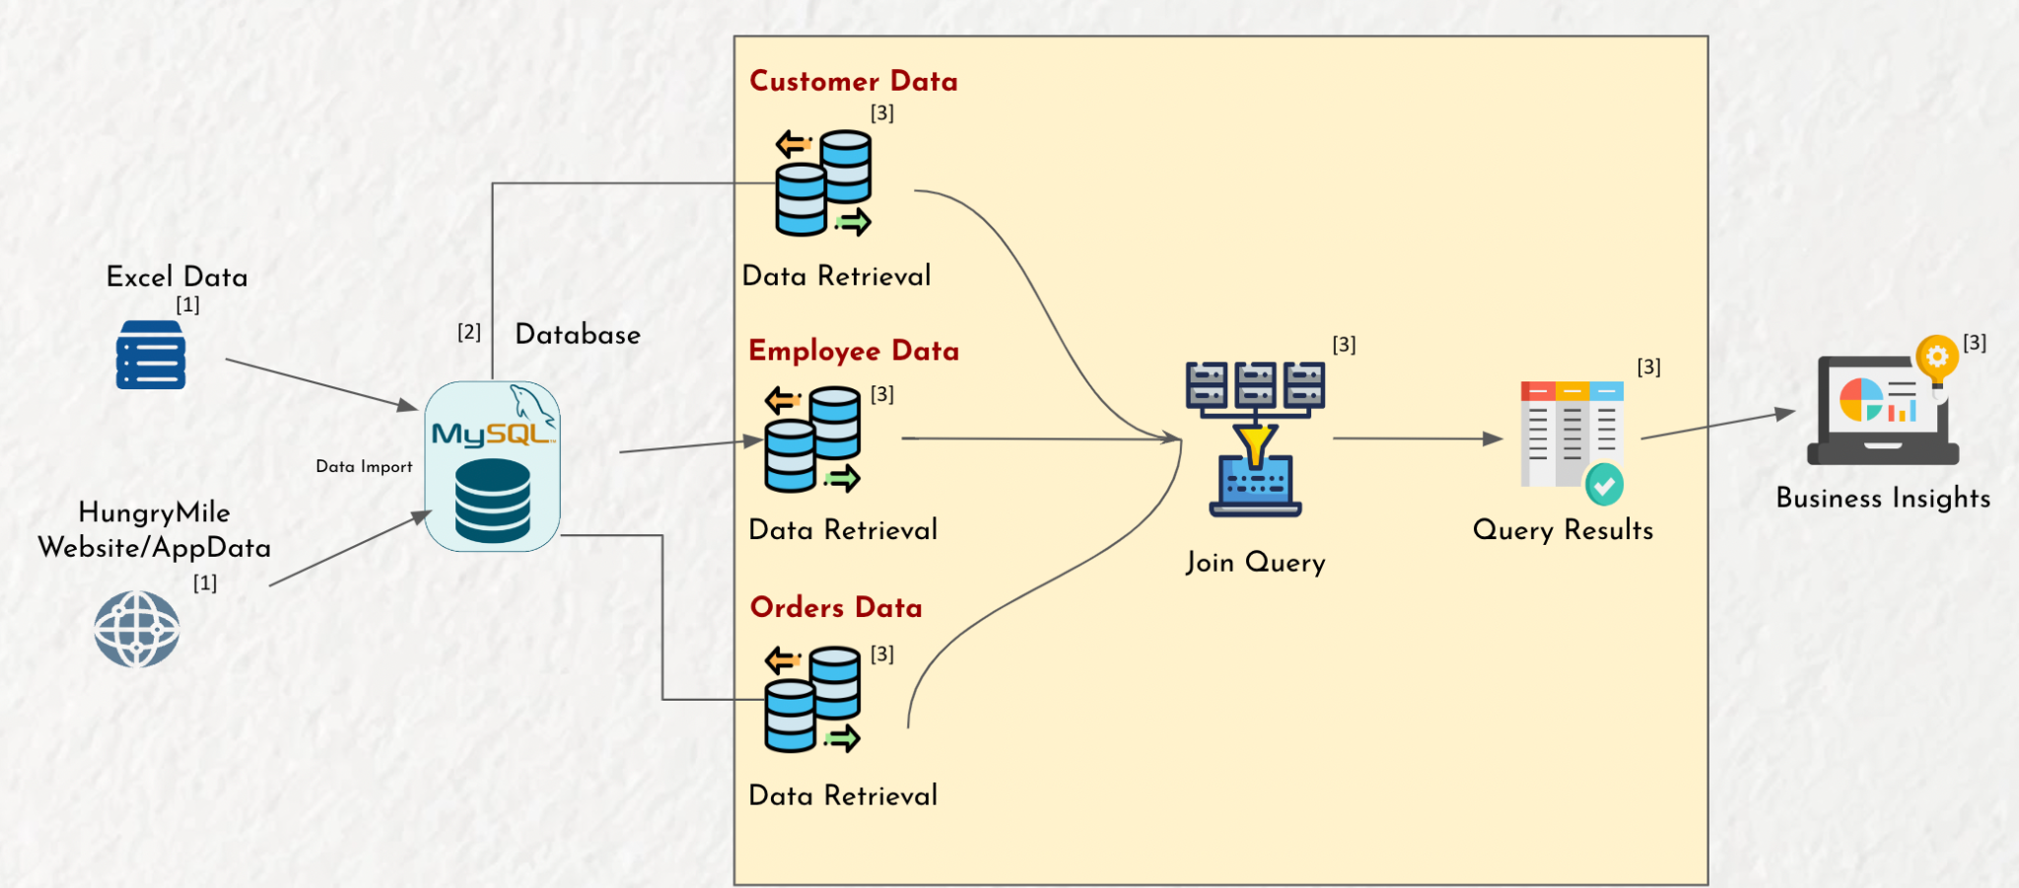
Current Situation
With Middleware + Excel
With mySQL

Slide 67
Low Level Architecture (Join Query)
Simple
HungryMile Website/AppData
Middleware Data dump
Manual Data transfer
^{[3]}
Excel Data
^{[1]}
^{[1]}
^{[1]}
^{[1]}
Business Insights
Data Retrieval
[1] Slidego (https://slidesgo.com)
[2] “Discover the Advantages of MySQL Design" (https://webuilddatabases.com/mysql-design/ )
[3] FlatIcon (https://www.flaticon.com )

Slide 68
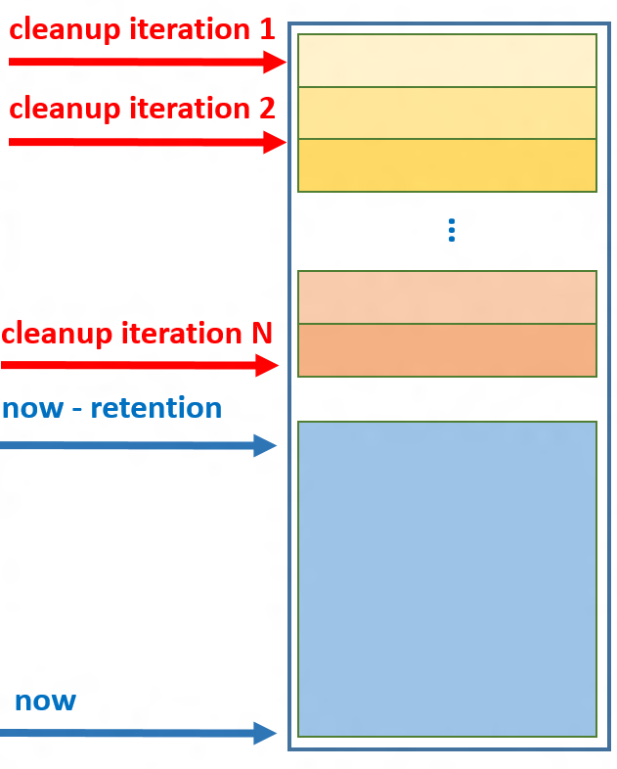
High Level Architecture
1
User Stories
Excel Data
1.5
Data clean-up & retention
^{[3]}
^{[1]}
2
Personas
Database
3
4
5
6
^{[3]}
7
- Join tables
- Fetch large amounts
of data
- Gain business insights
^{[3]}
^{[3]}
^{[3]}
^{[3]}
Data Import
Business Analyst
^{[3}
Relational Modeling
^{[3]}
- Extract large datasets
- Get financial and
customer data
- Provide insights
^{[2]}
Schema Design
Data Retrieval
Joining tables
Business Insights
Data Analyst
^{[4]}
[1] Slidego (https://slidesgo.com)
[2] “Discover the Advantages of MySQL Design" (https://webuilddatabases.com/mysql-design/ )
[3] FlatIcon (https://www.flaticon.com )
[4] Manage retention of historical data in system-versioned temporal tables (https://docs.microsoft.com/en-us/sql/relational-databases/tables/manage-retention-of-historical-data-in-system-versioned-temporal-tables?view=sql-server-ver16 )

